Slide 1

建構彈性高效能的超融合架構 Microsoft S2D 軟體定義儲存技術

Slide 2
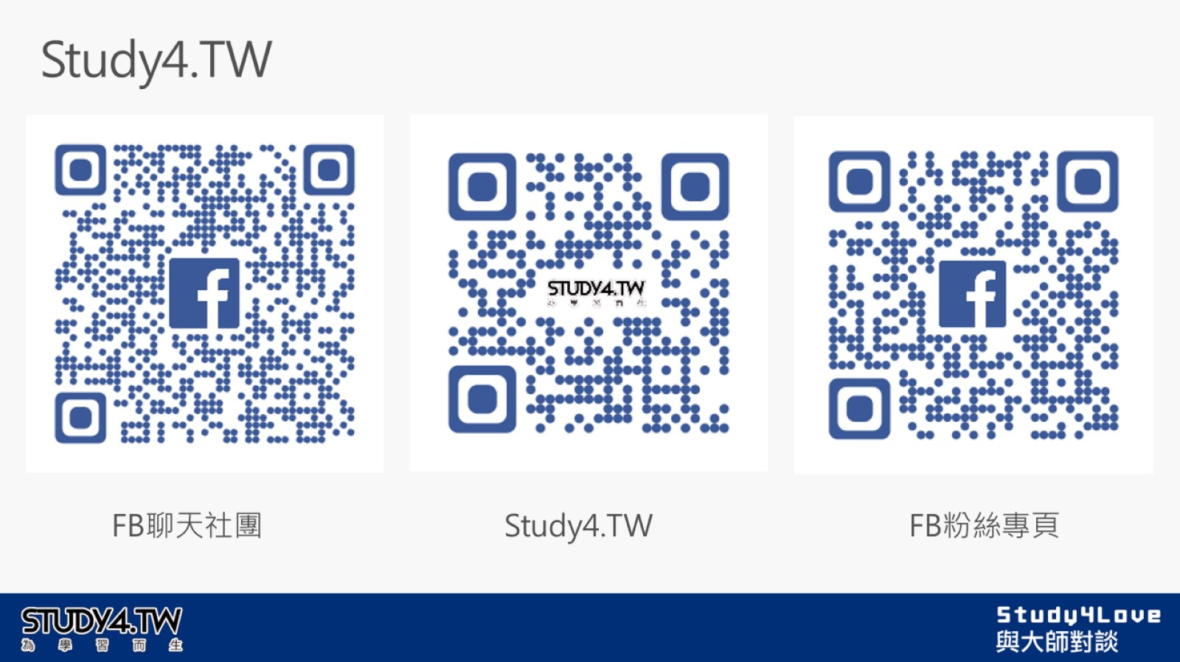
Study4.TW

Slide 3
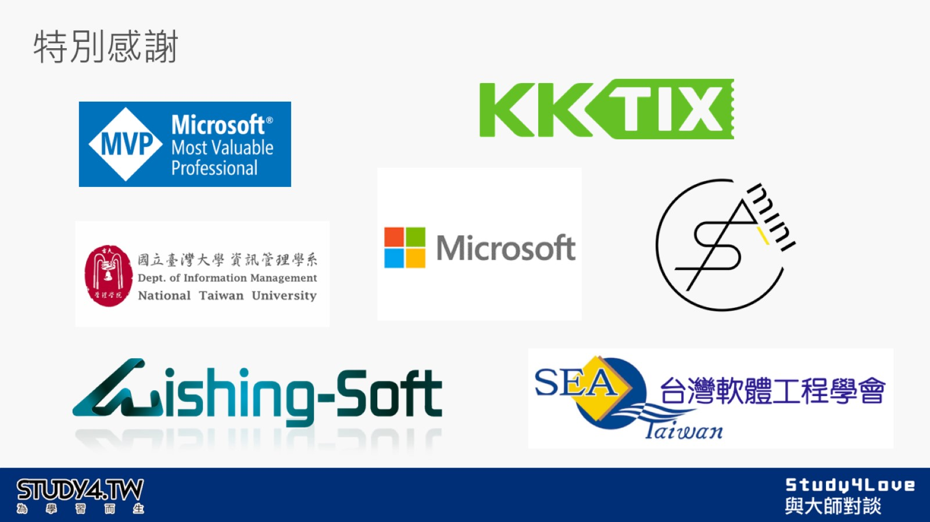
特別感謝

Slide 4
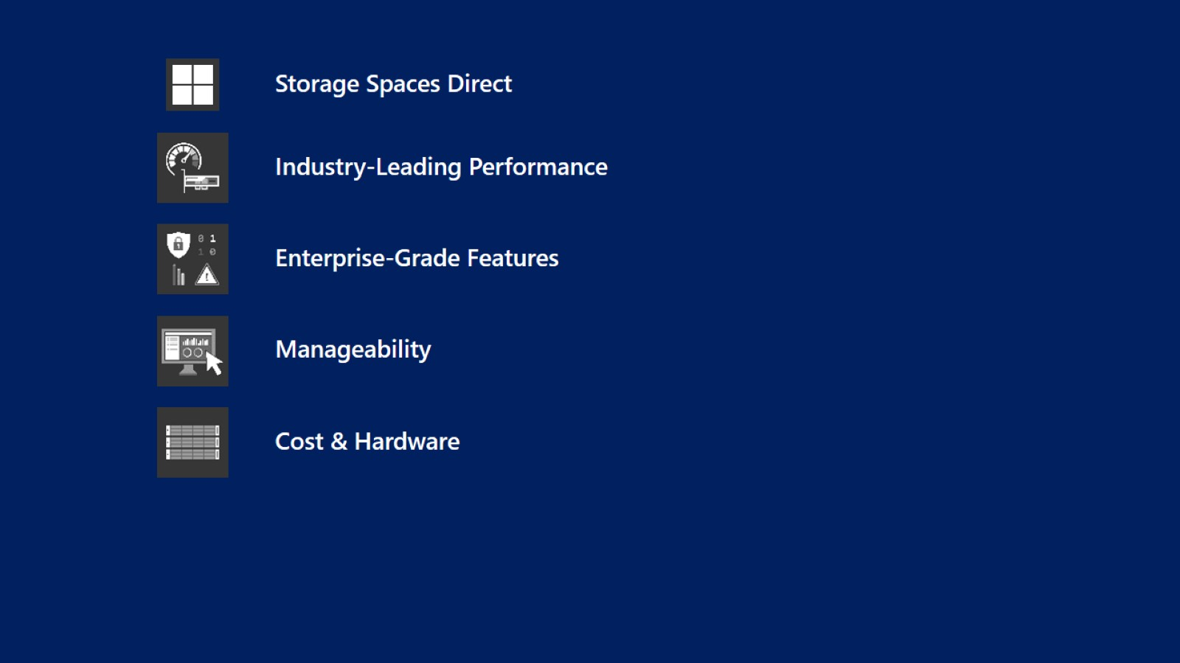

Slide 5
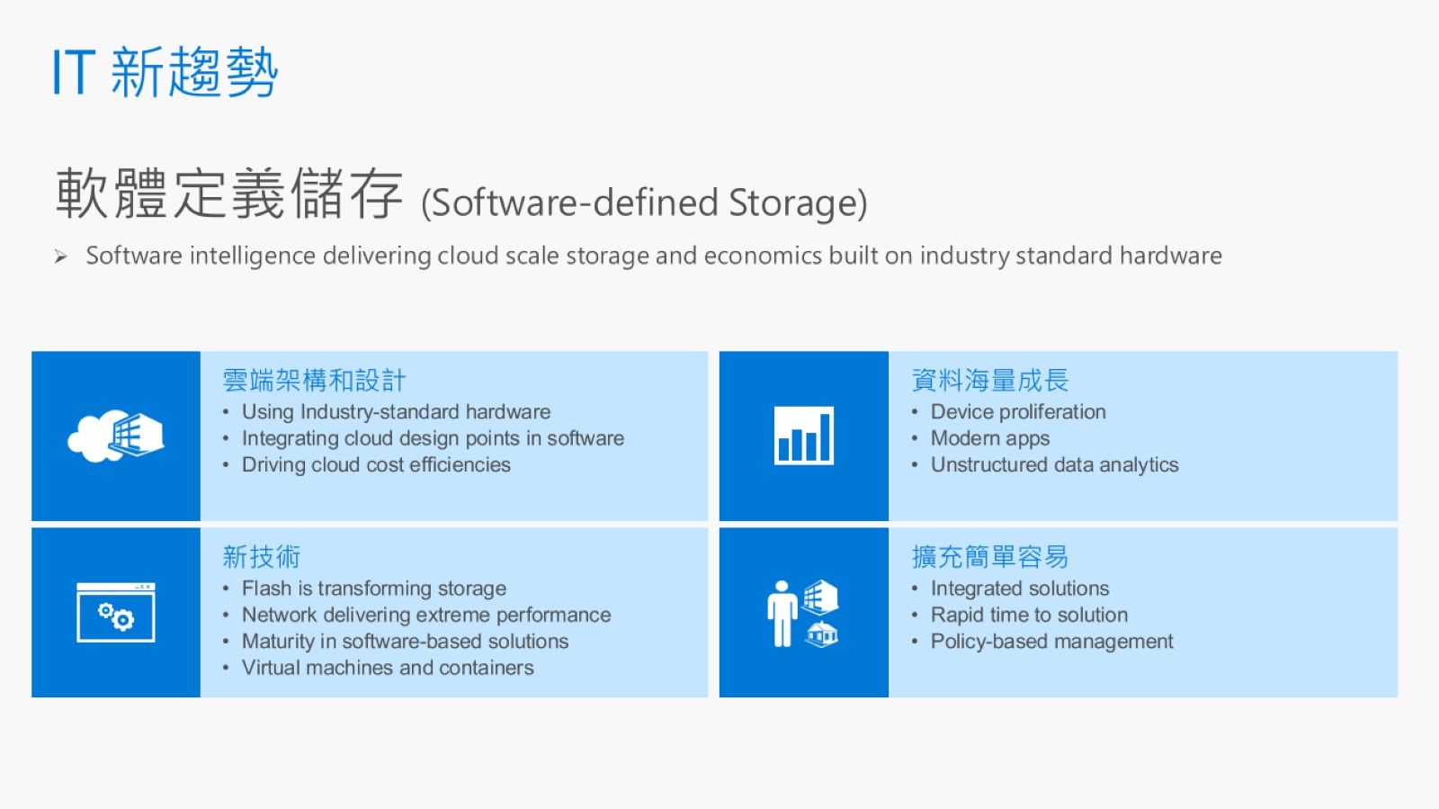
IT 新趨勢

Slide 6
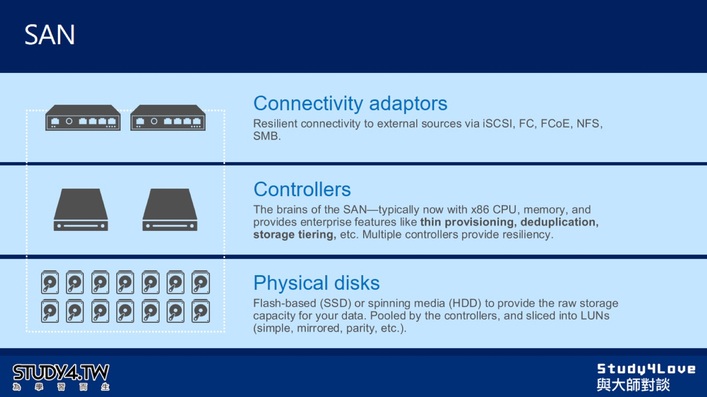
SAN

Slide 7
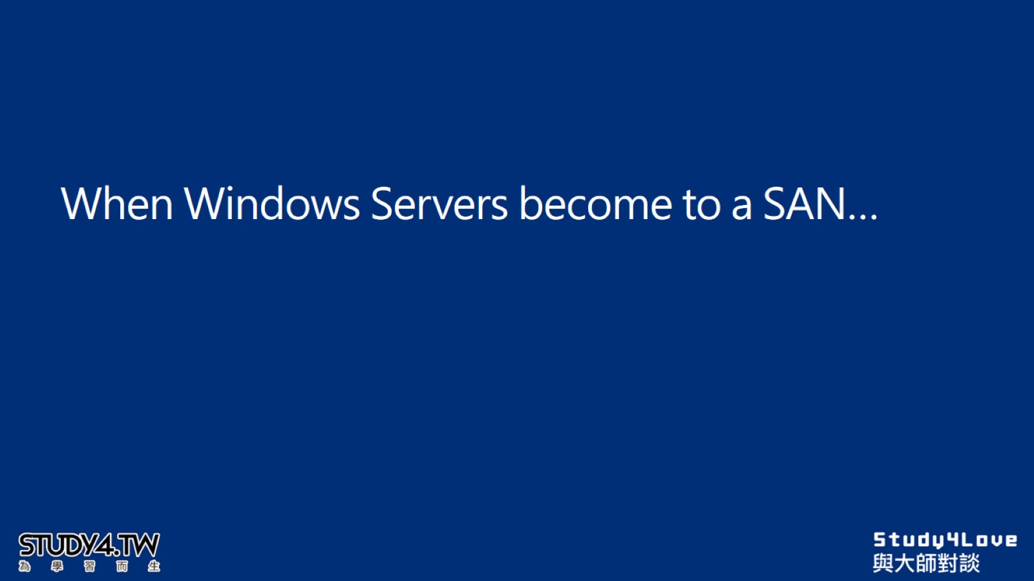
When Windows Servers become to a SAN…

Slide 8
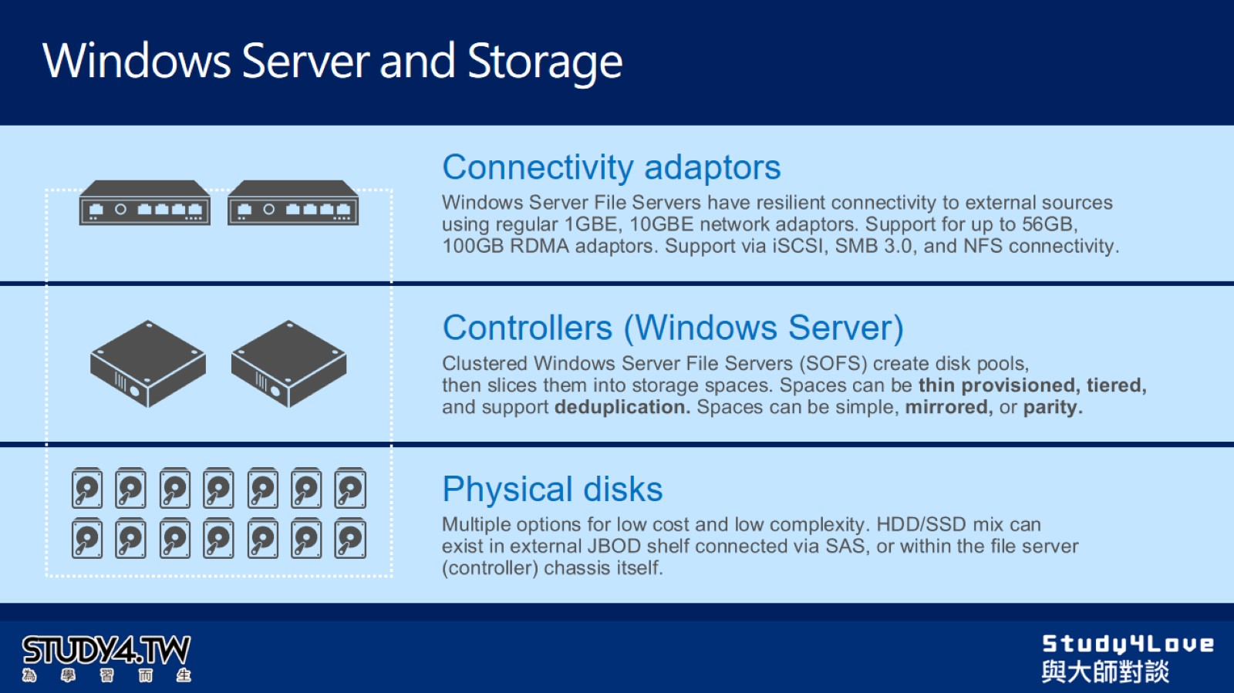
Windows Server and Storage

Slide 9
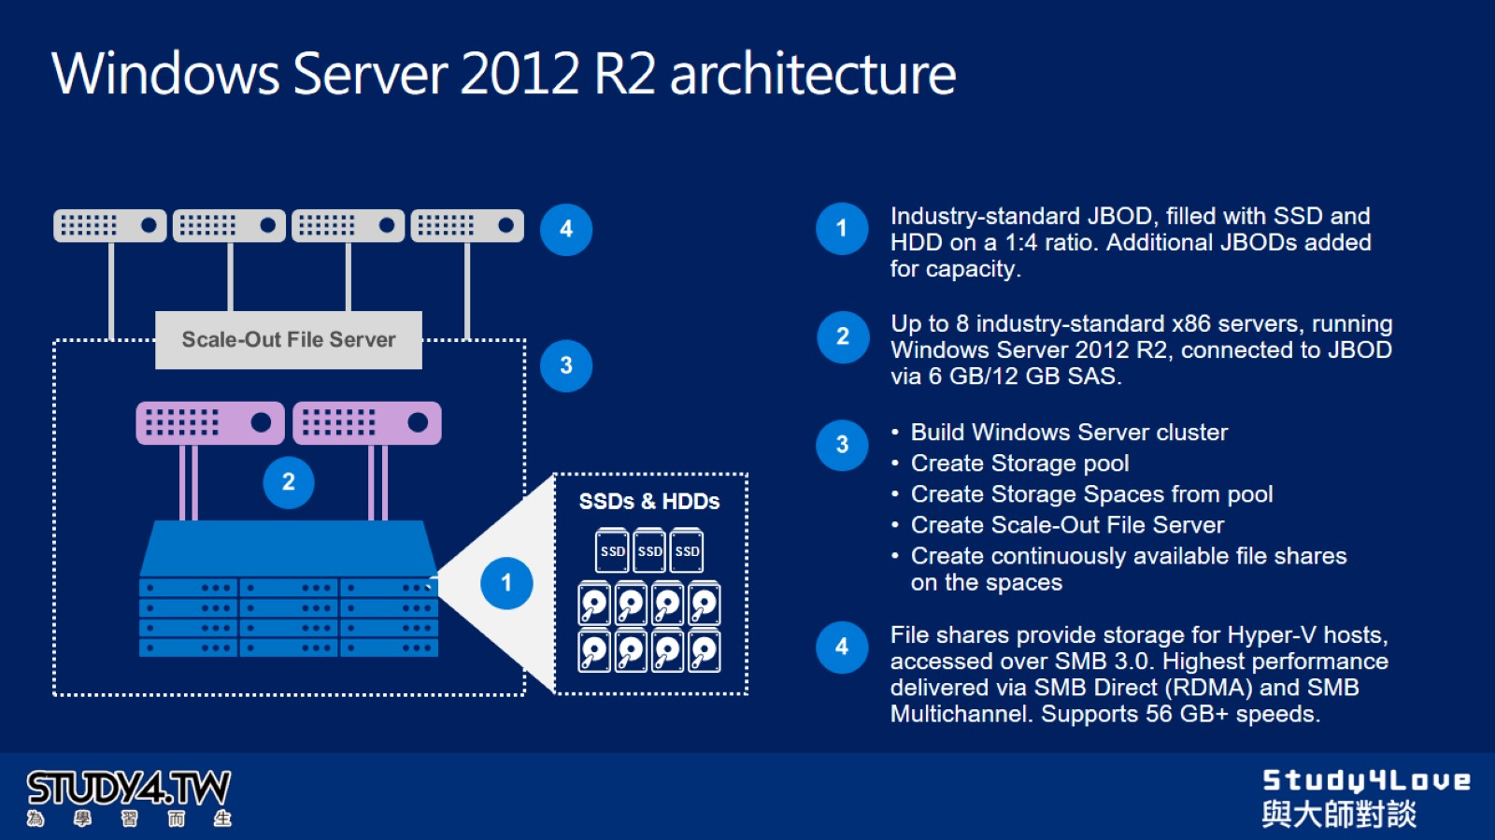
Windows Server 2012 R2 architecture

Slide 10
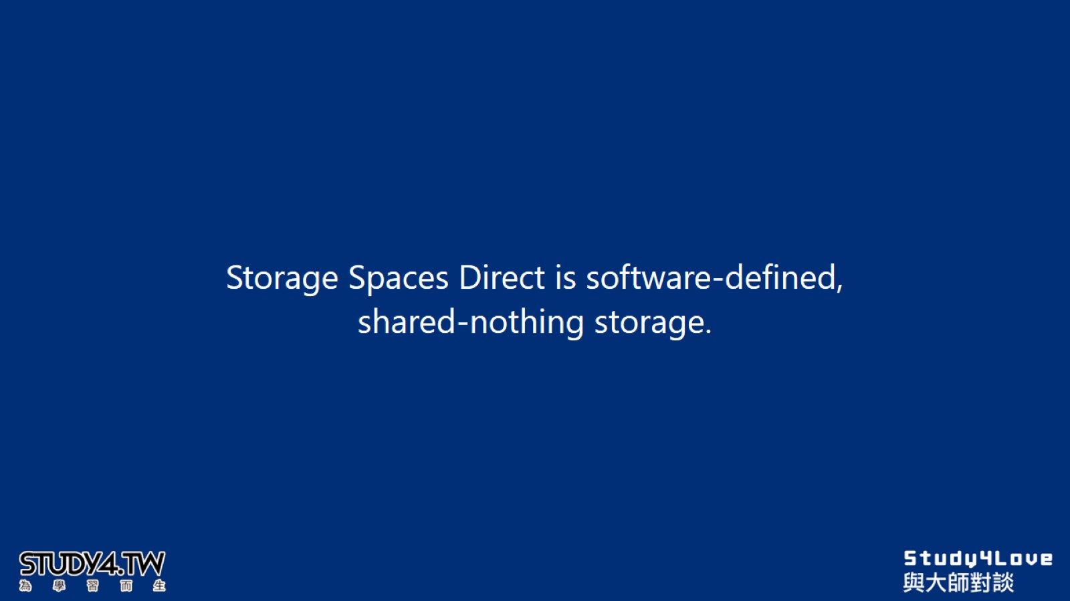

Slide 11
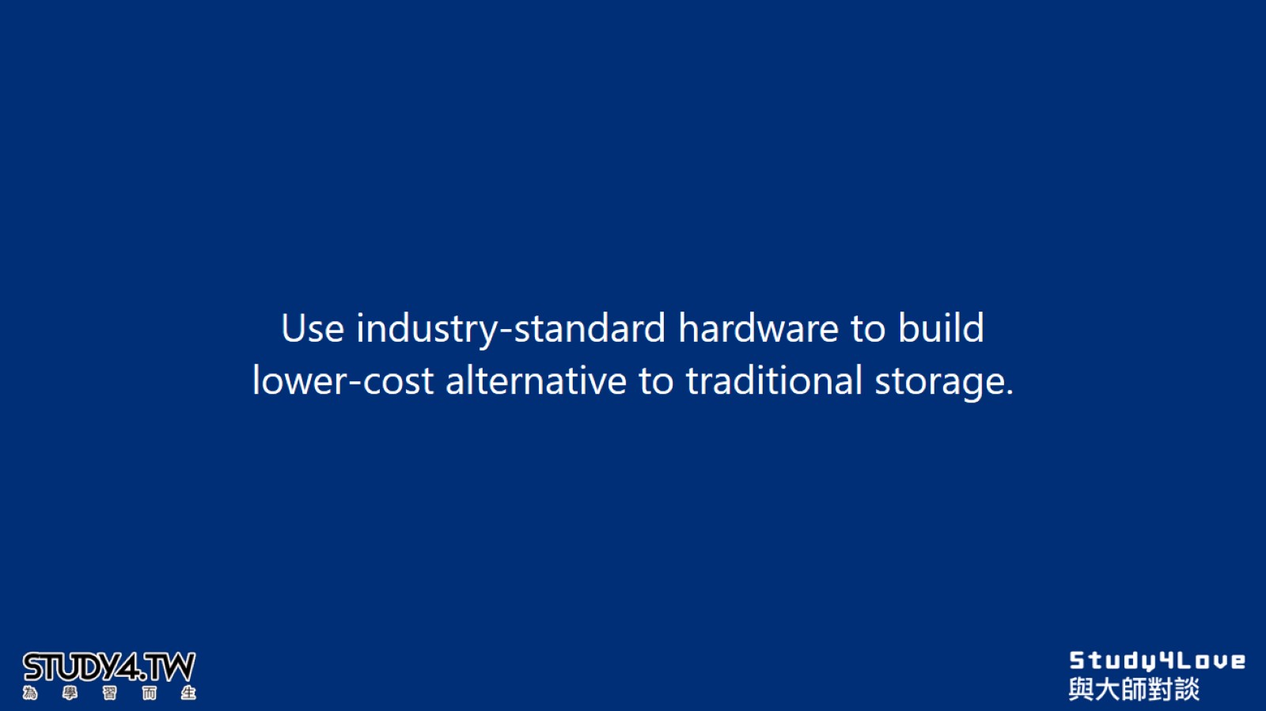

Slide 12
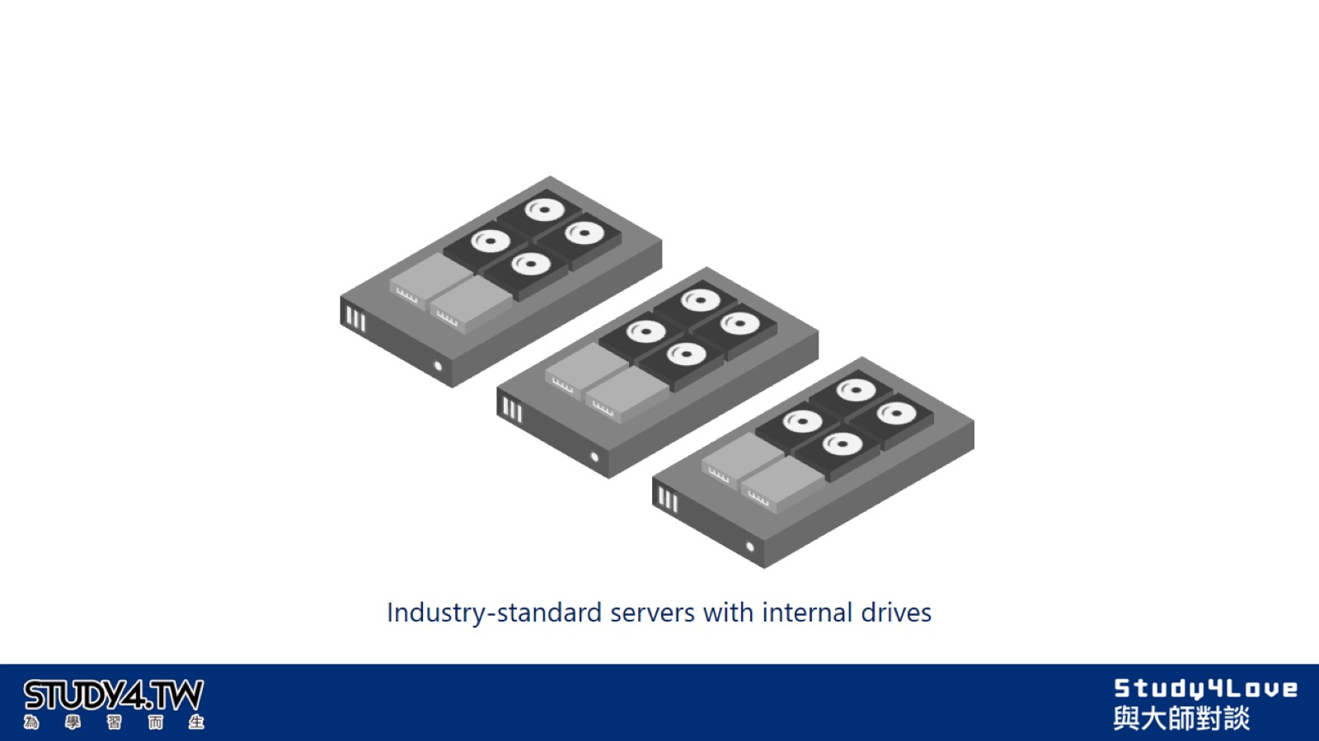

Slide 13


Slide 14
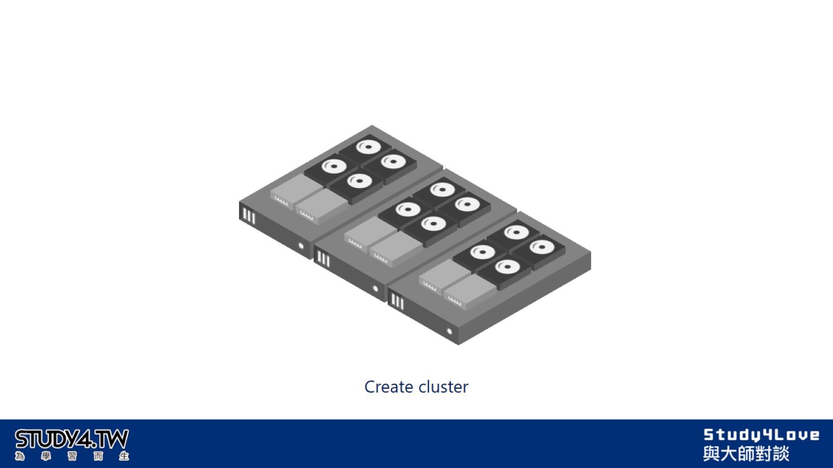

Slide 15
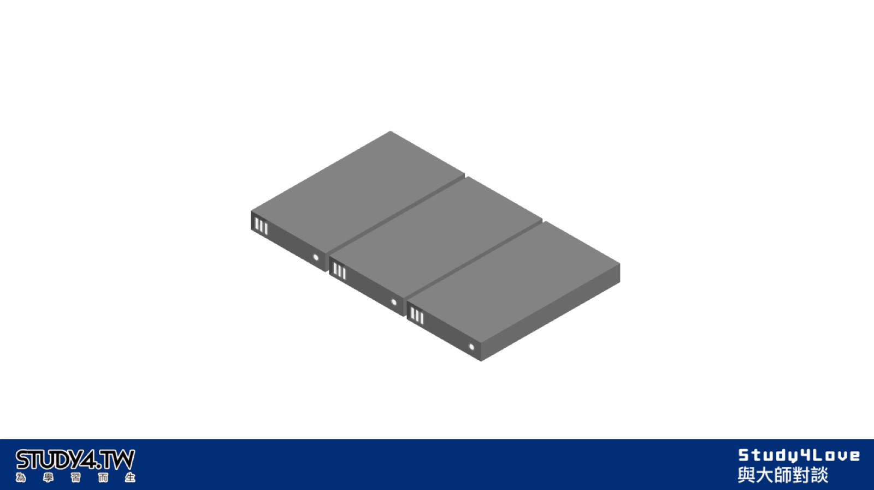

Slide 16
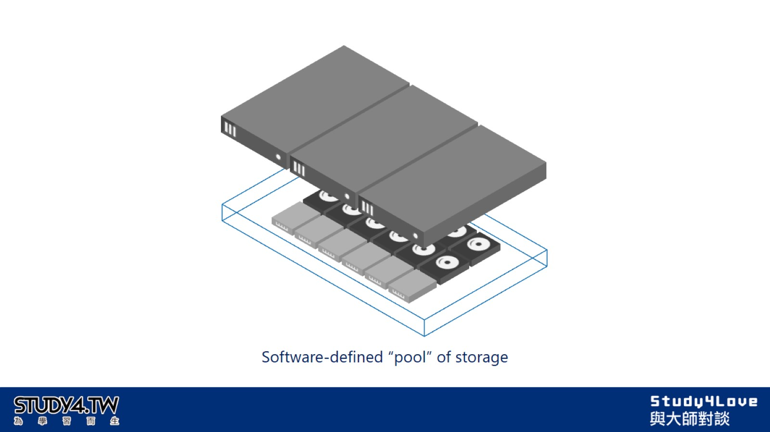

Slide 17
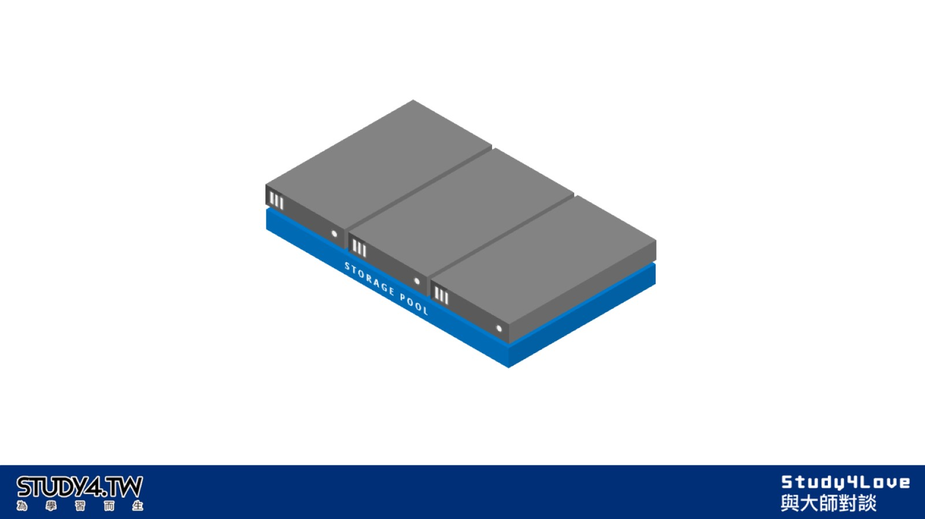

Slide 18
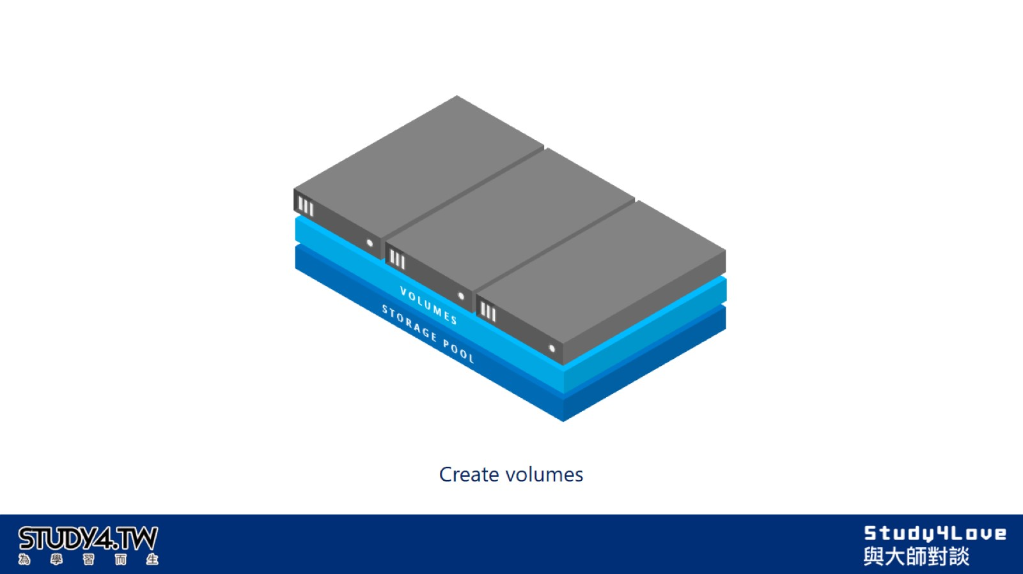

Slide 19
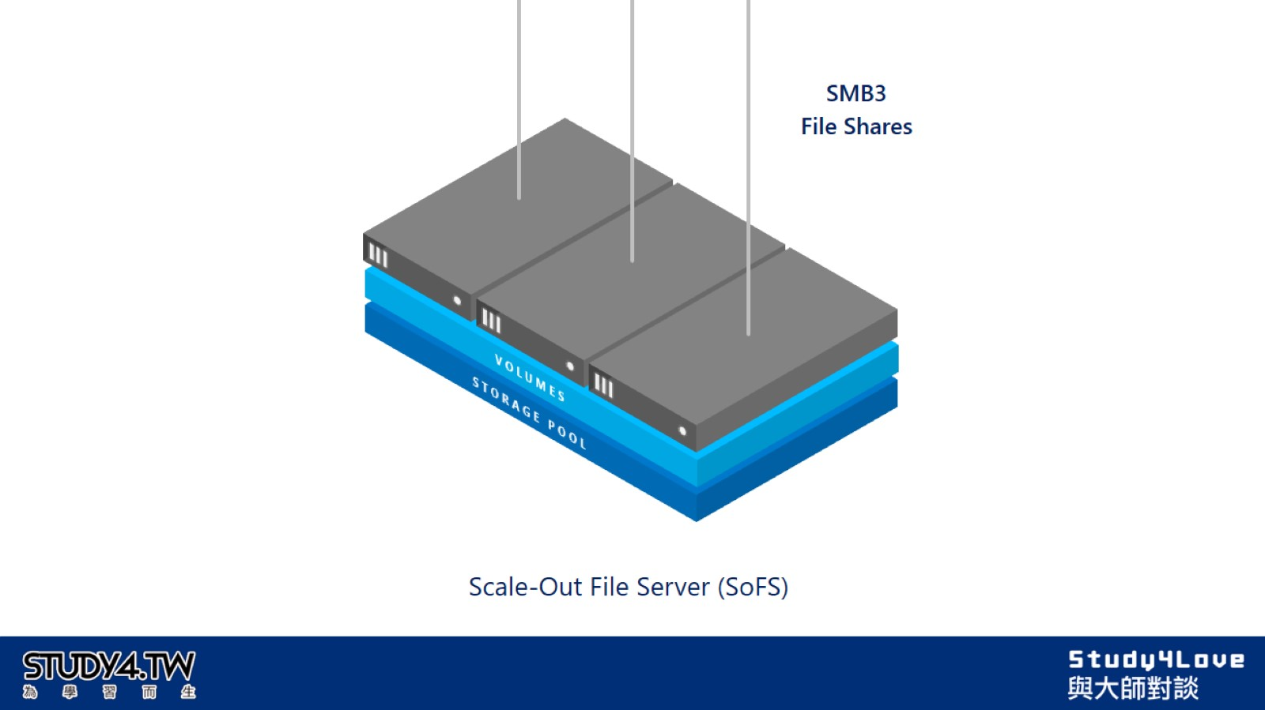

Slide 20
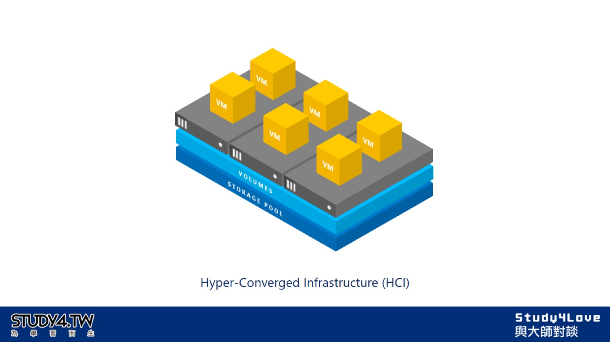

Slide 21
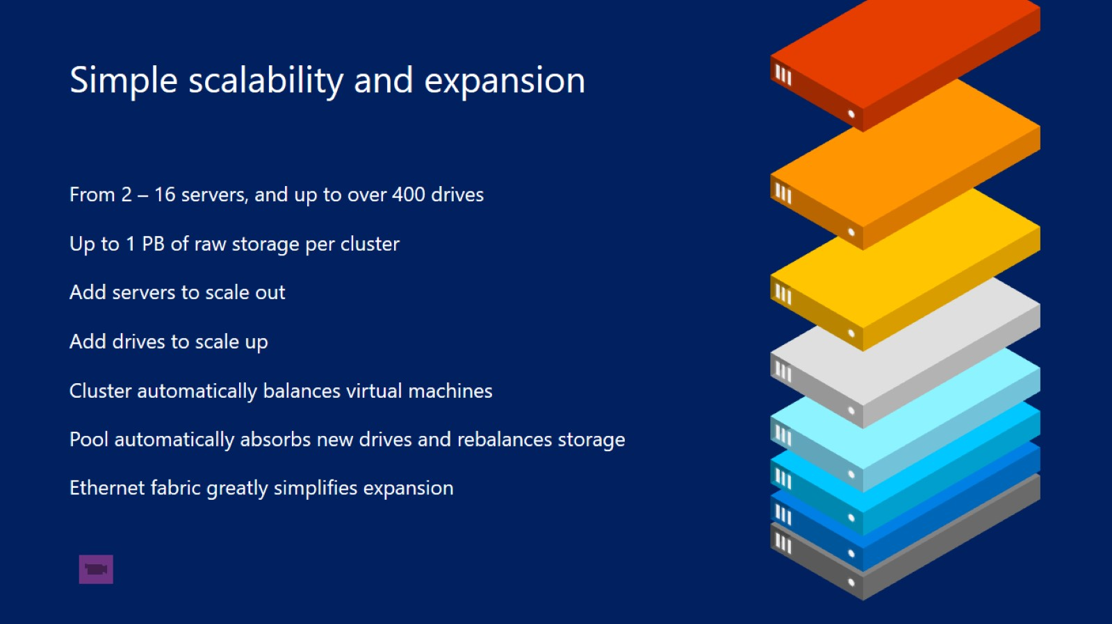

Slide 22
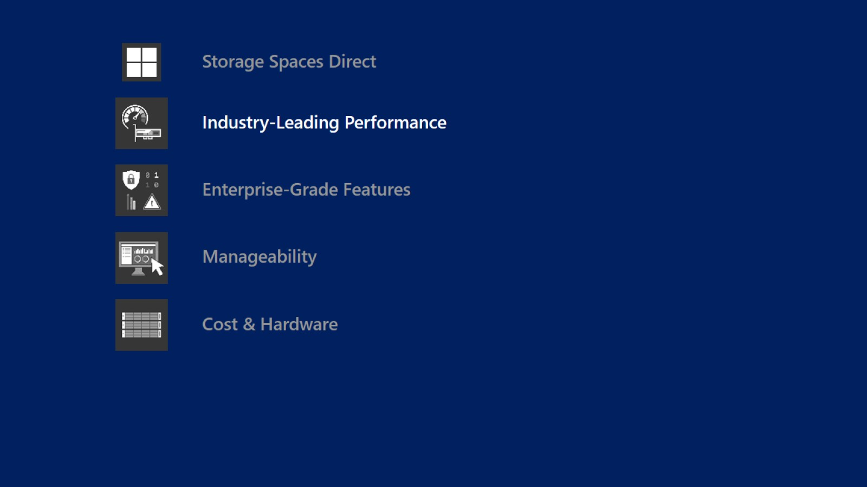

Slide 23
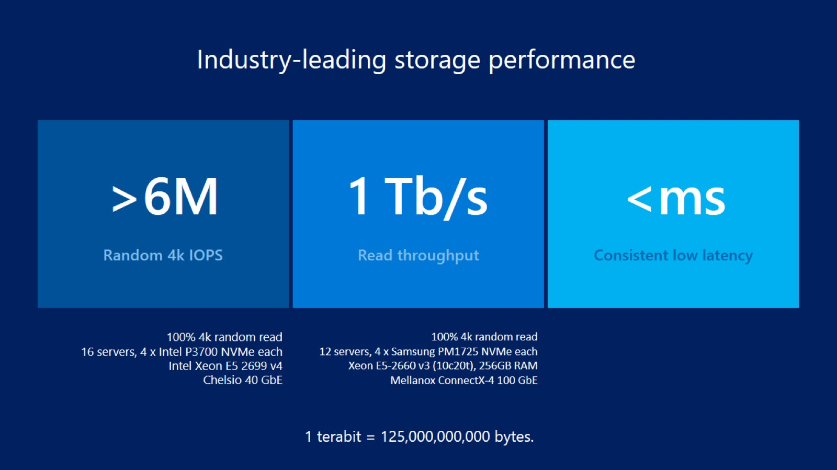

Slide 24
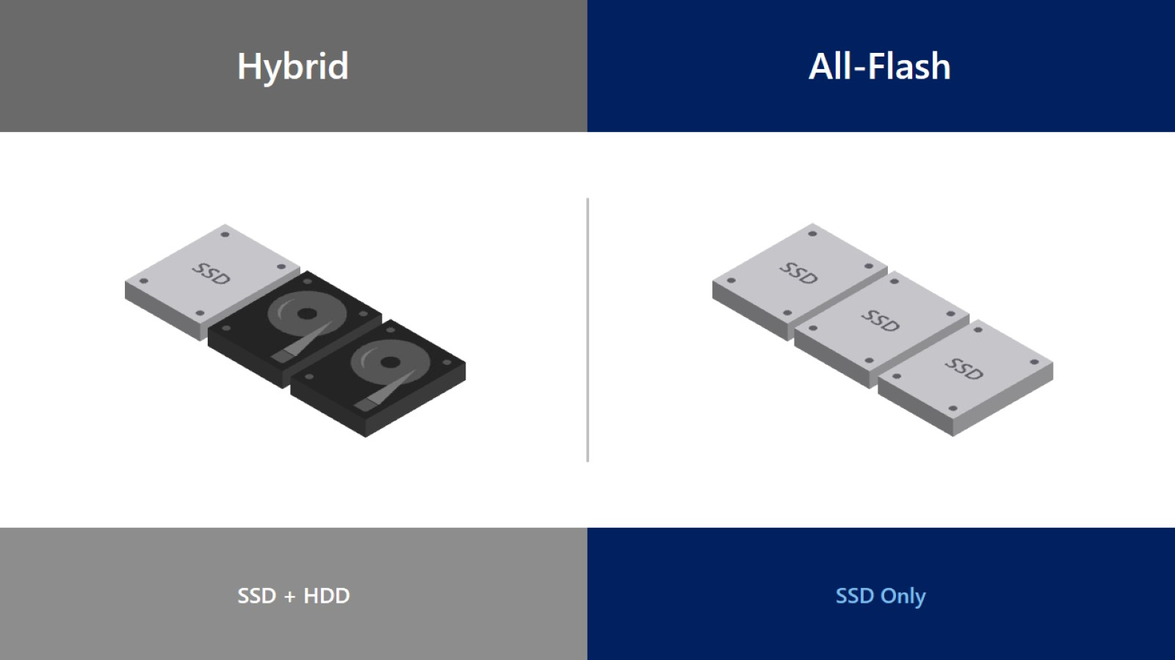

Slide 25
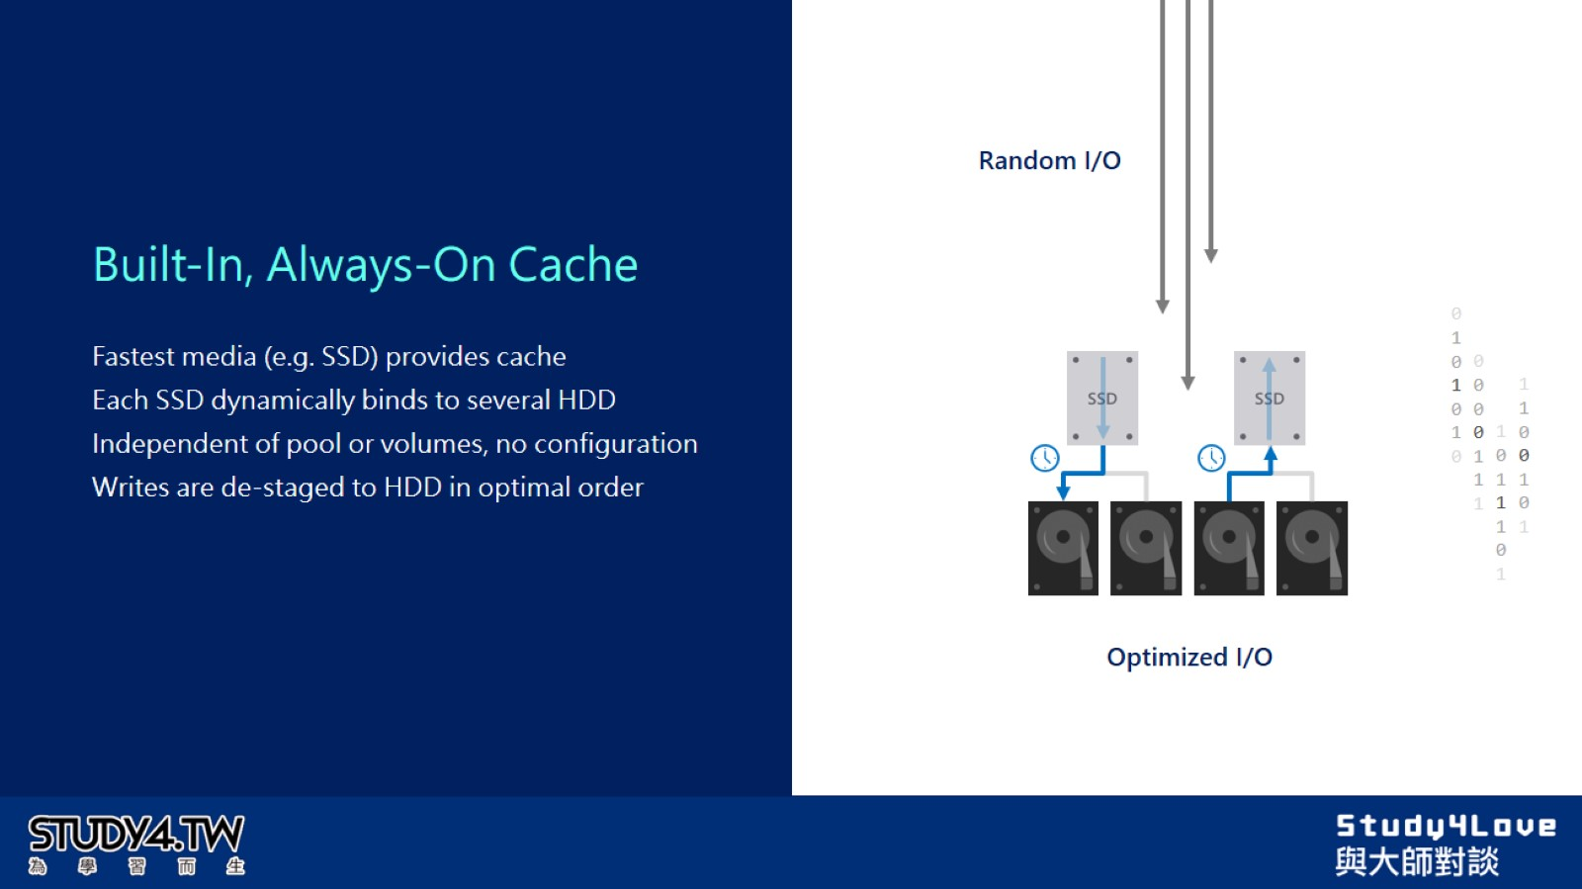

Slide 26
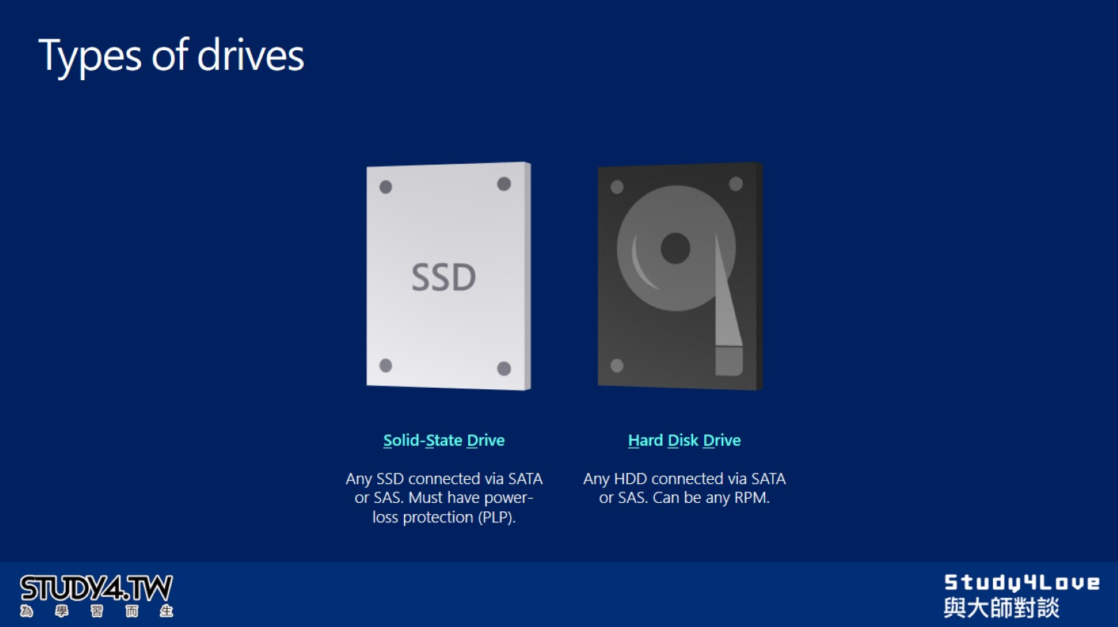
Types of drives

Slide 27
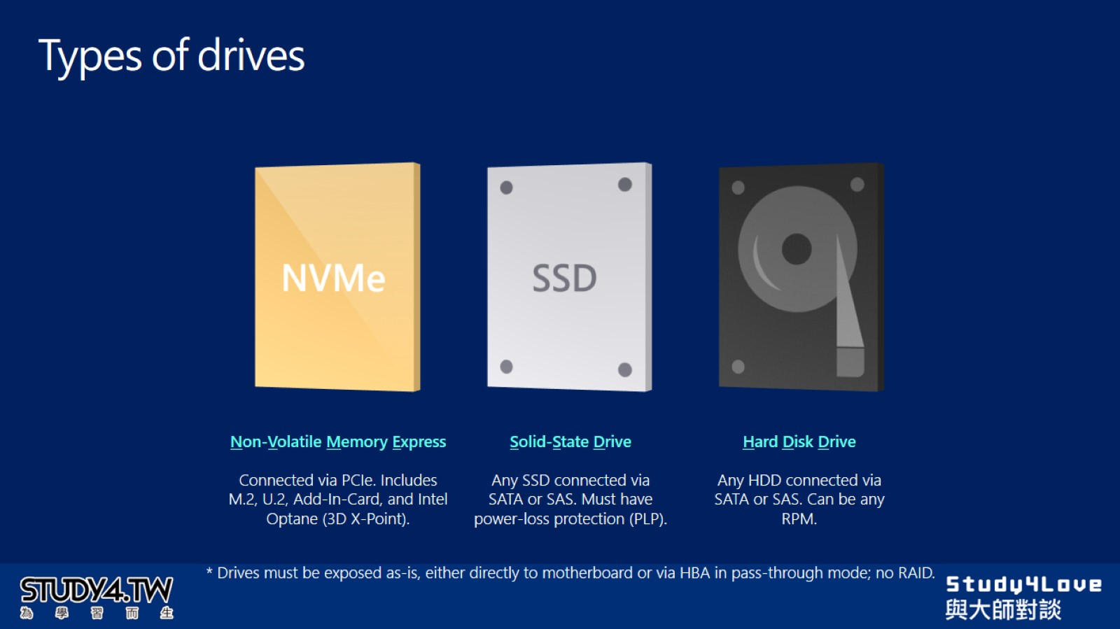
Types of drives

Slide 28
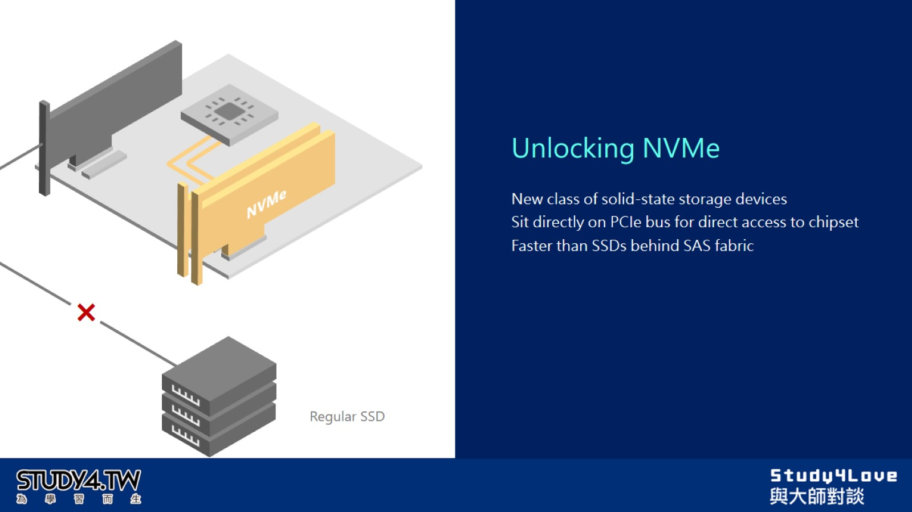

Slide 29
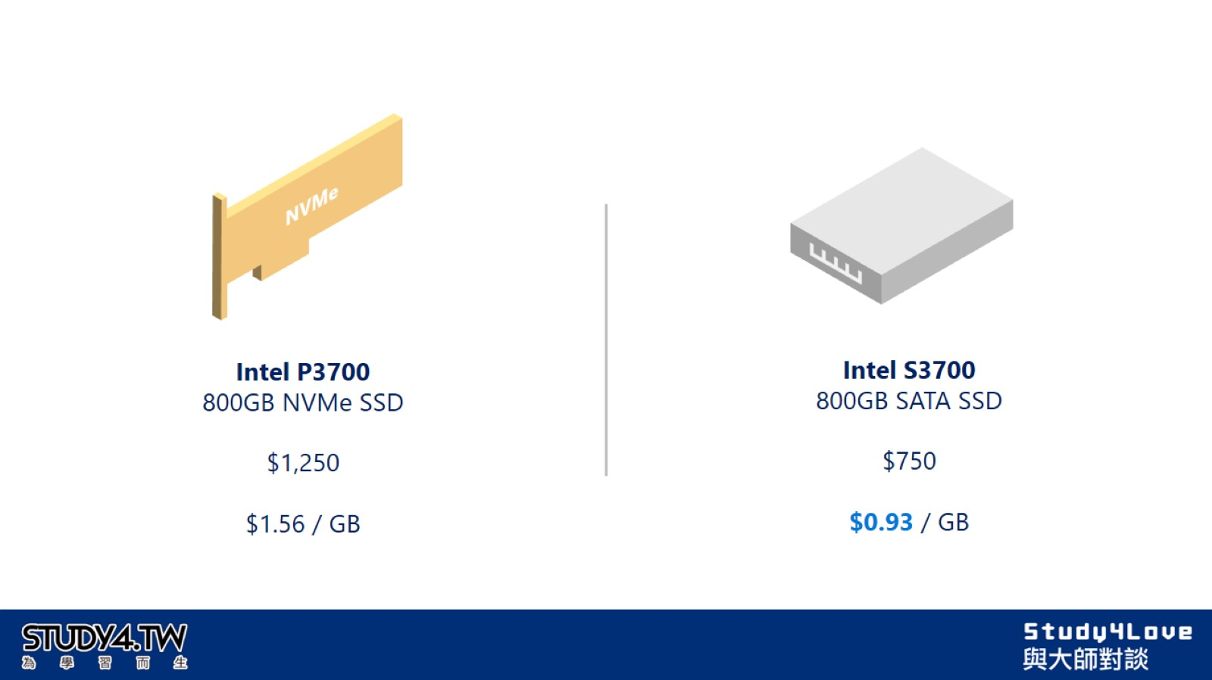

Slide 30
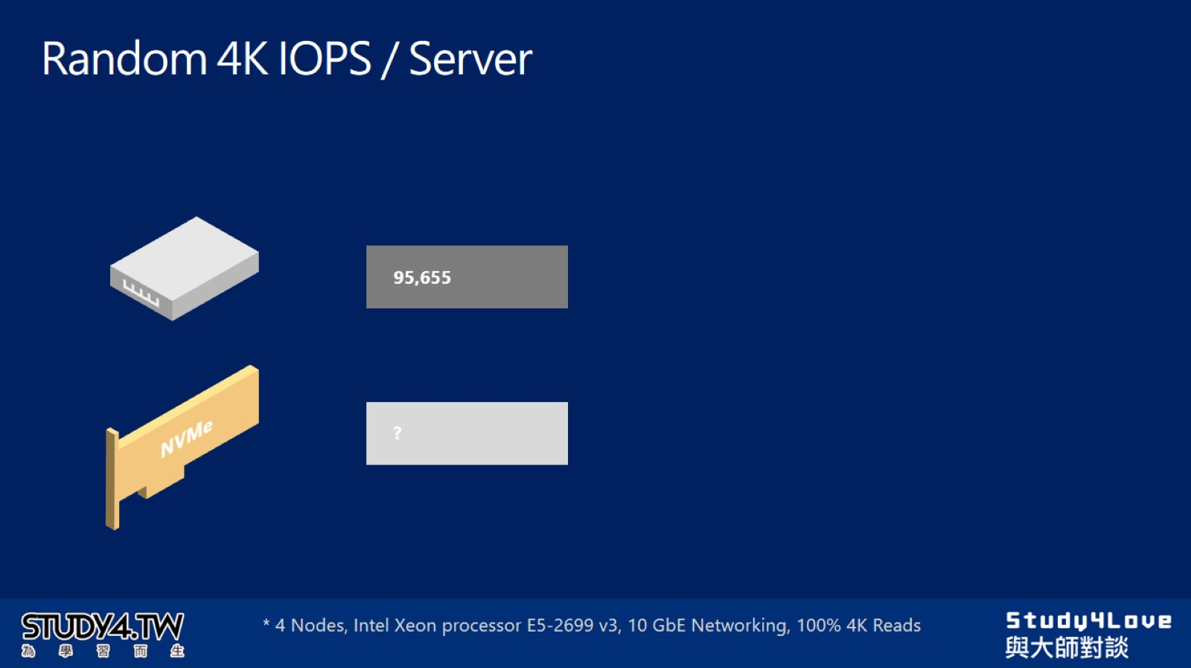
Random 4K IOPS / Server

Slide 31
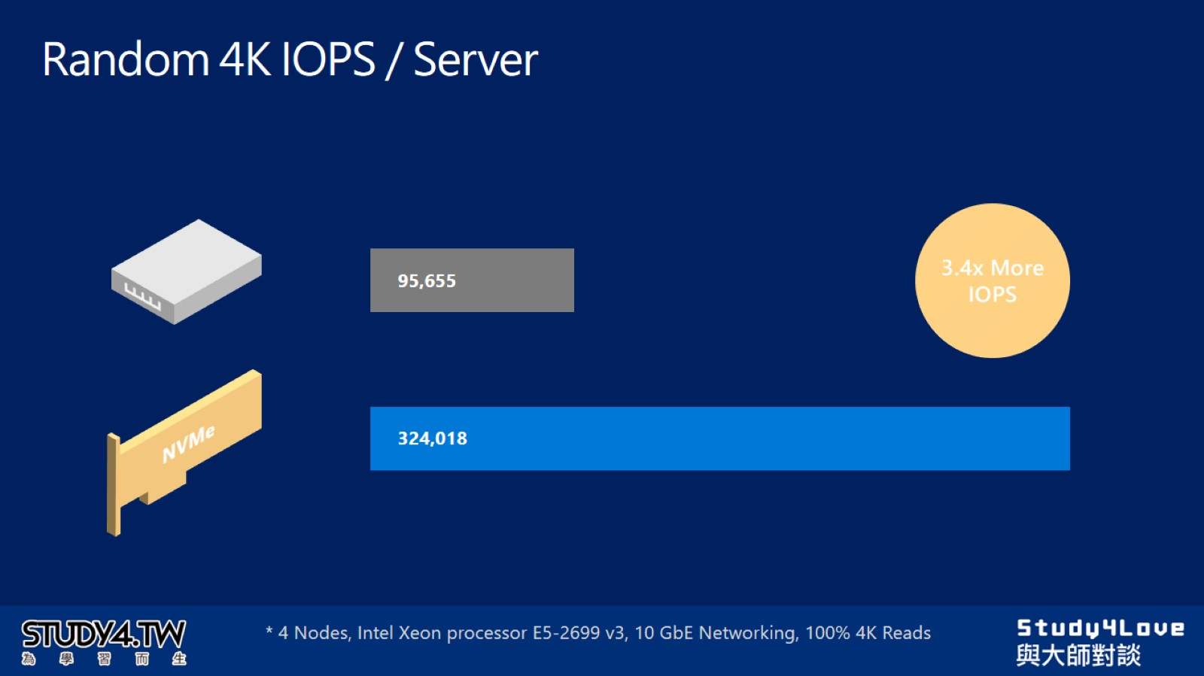
Random 4K IOPS / Server

Slide 32
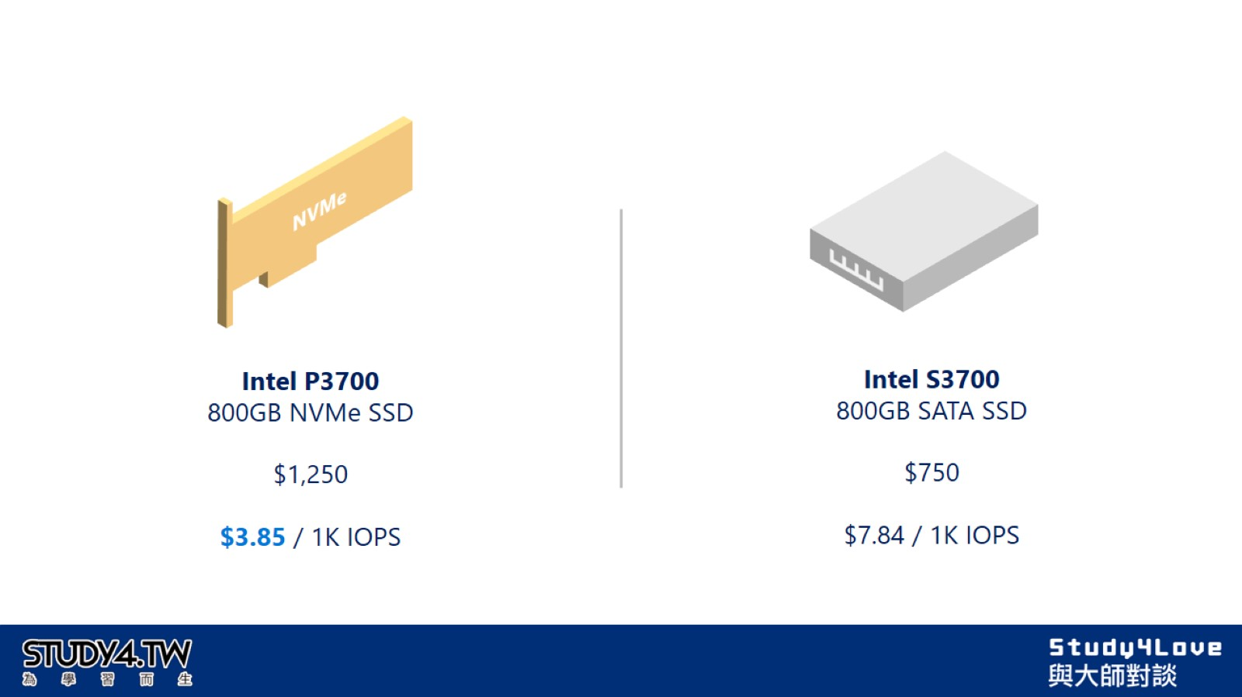

Slide 33
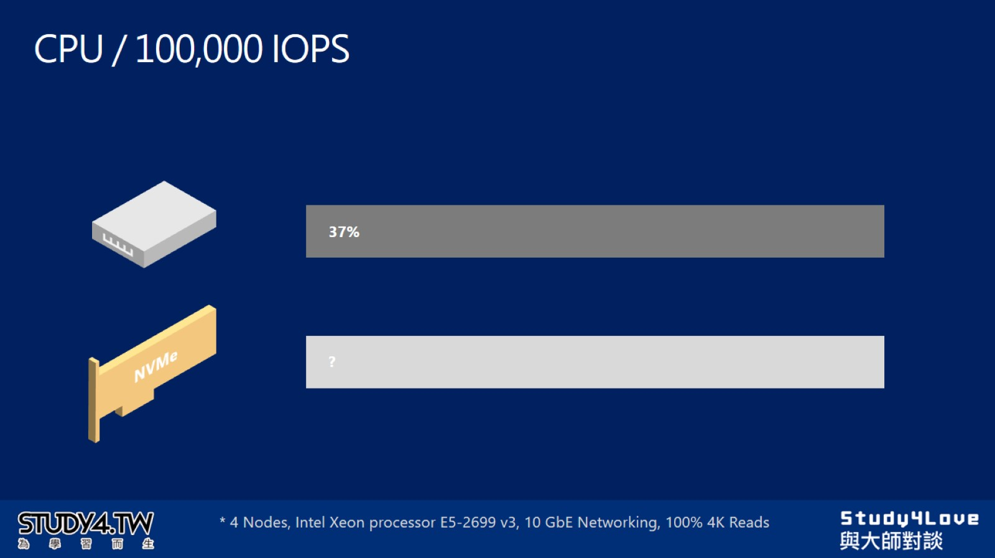
CPU / 100,000 IOPS

Slide 34
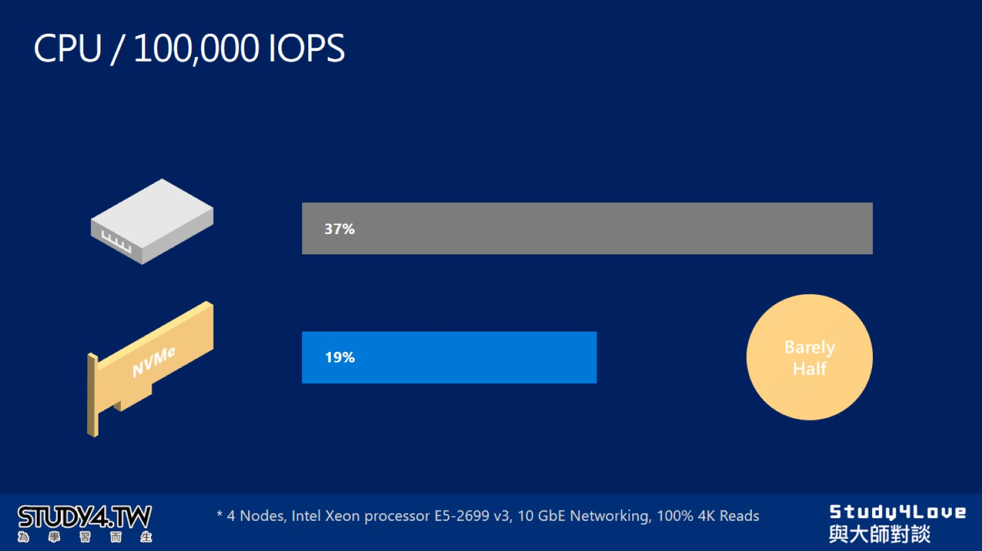
CPU / 100,000 IOPS

Slide 35
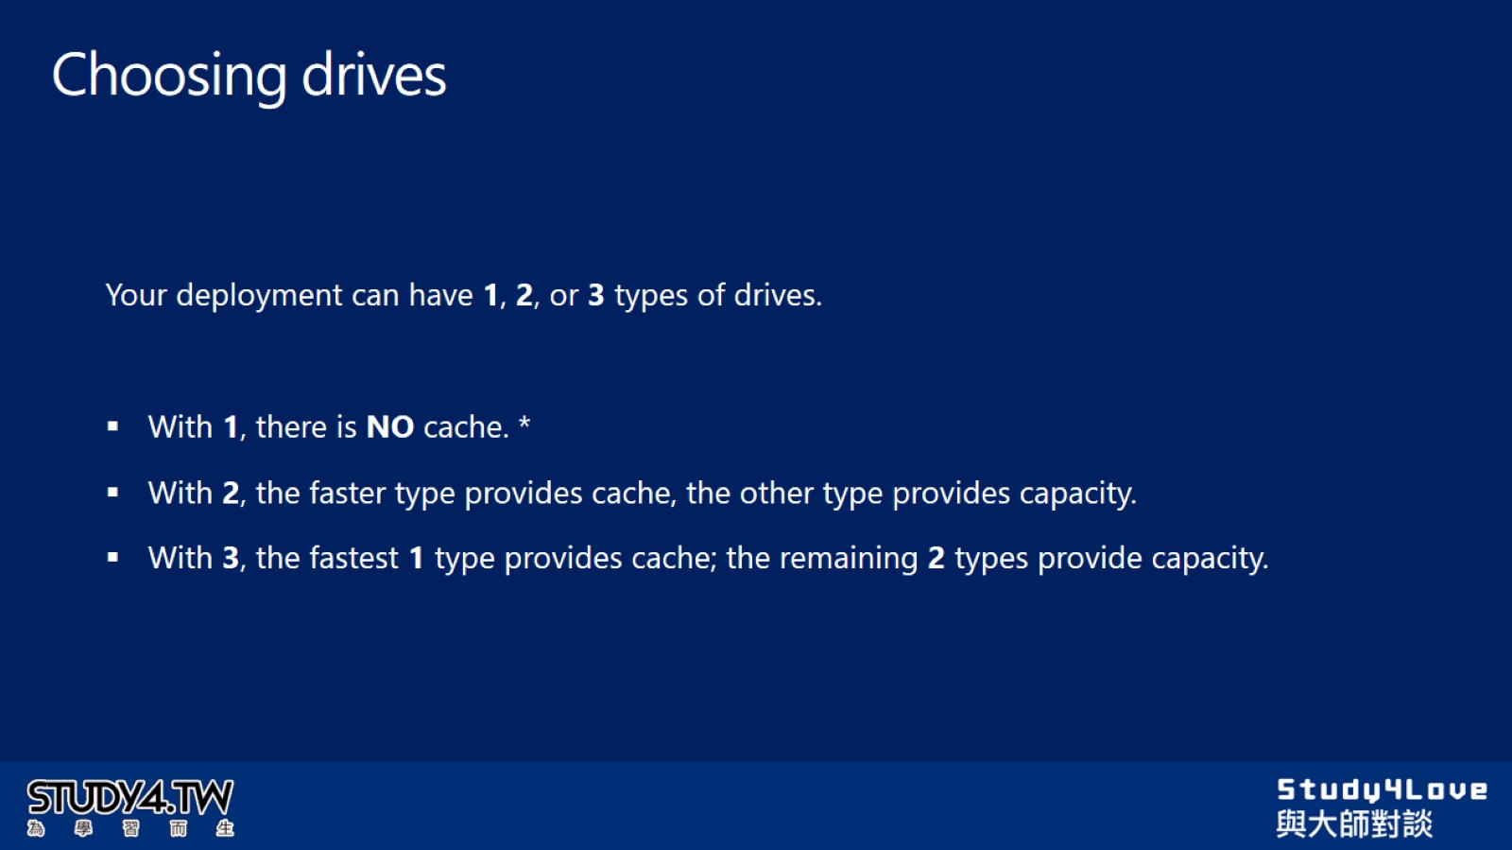
Choosing drives

Slide 36
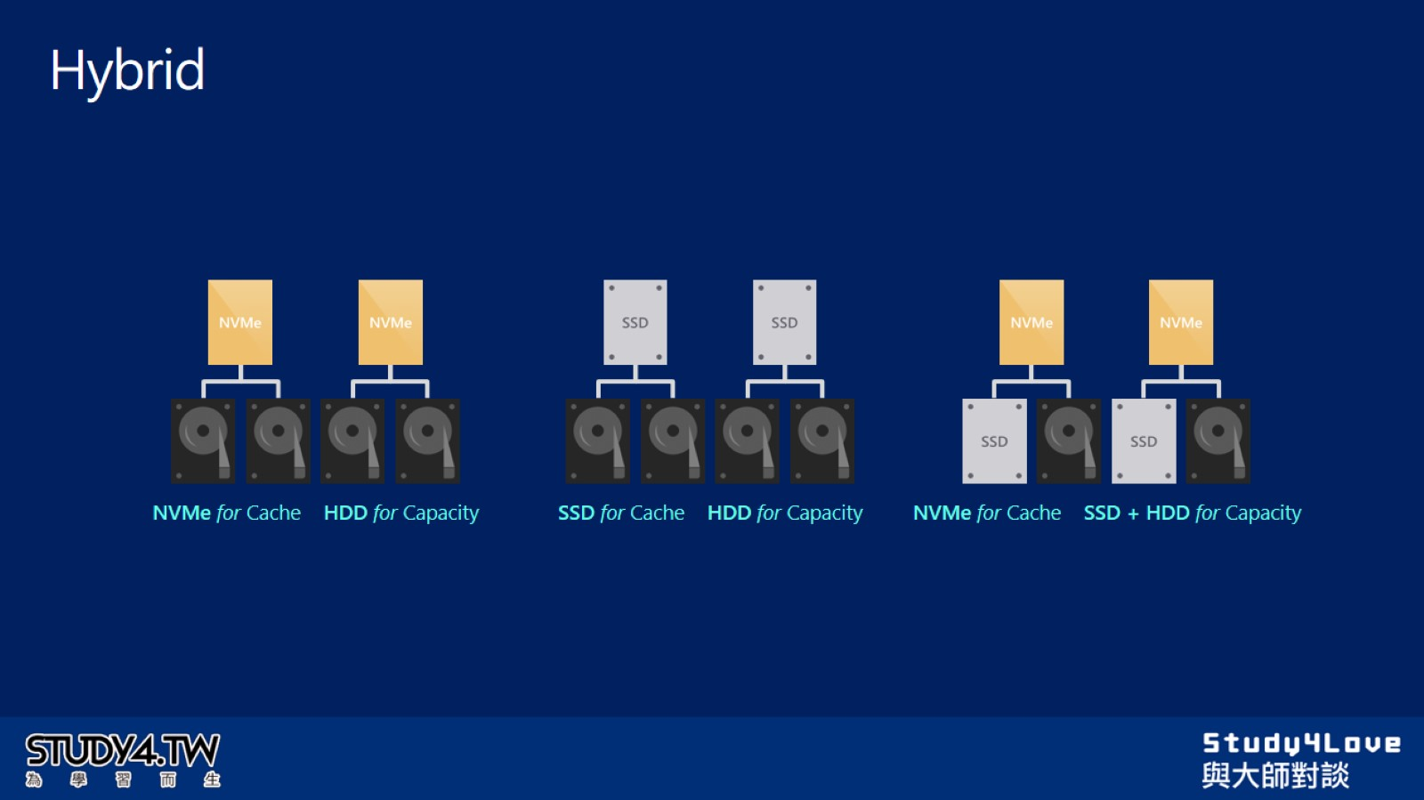
Hybrid

Slide 37
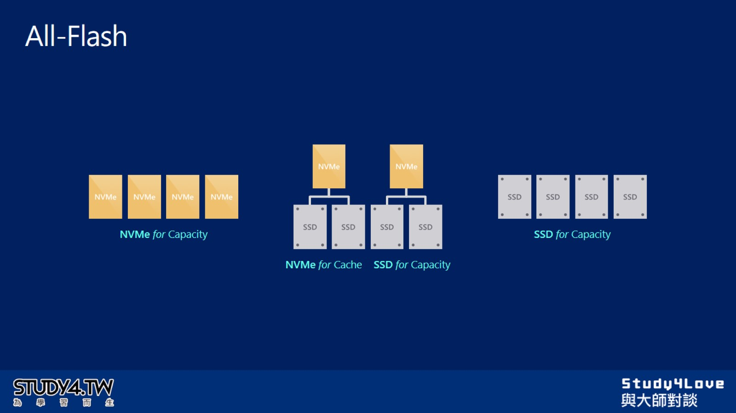
All-Flash

Slide 38
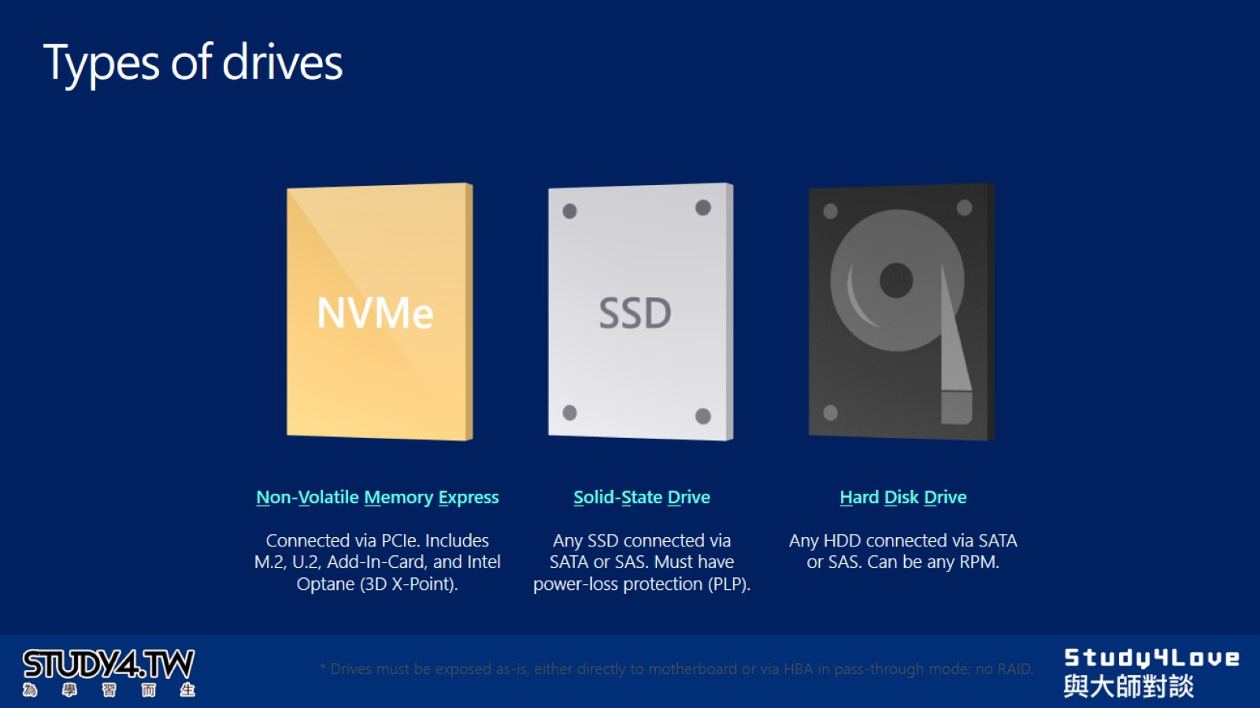
Types of drives

Slide 39
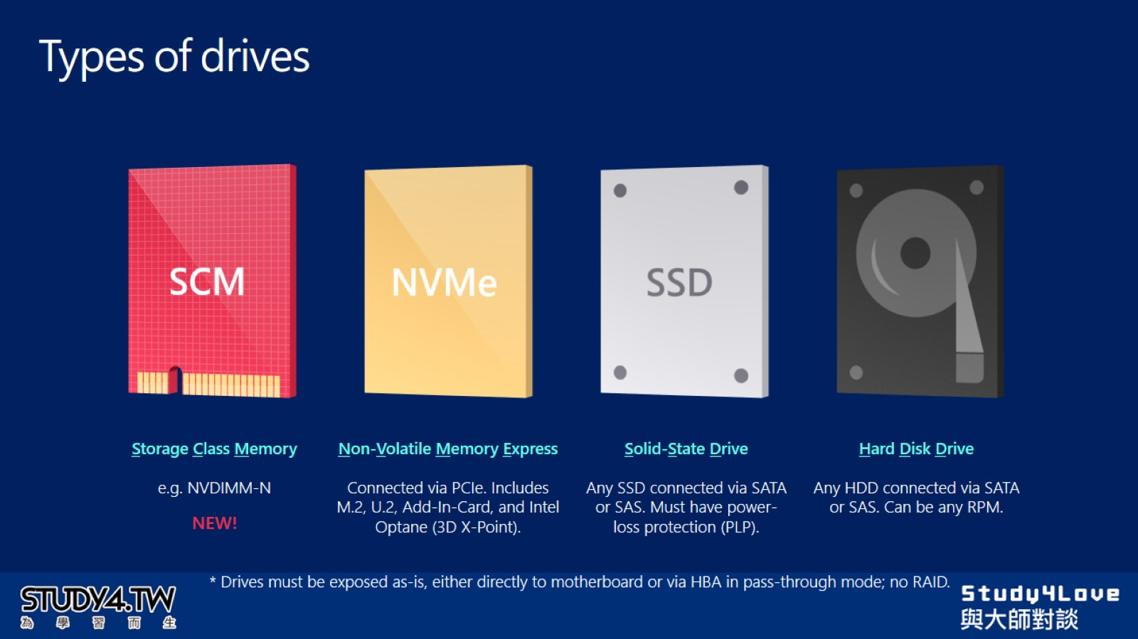
Types of drives

Slide 40
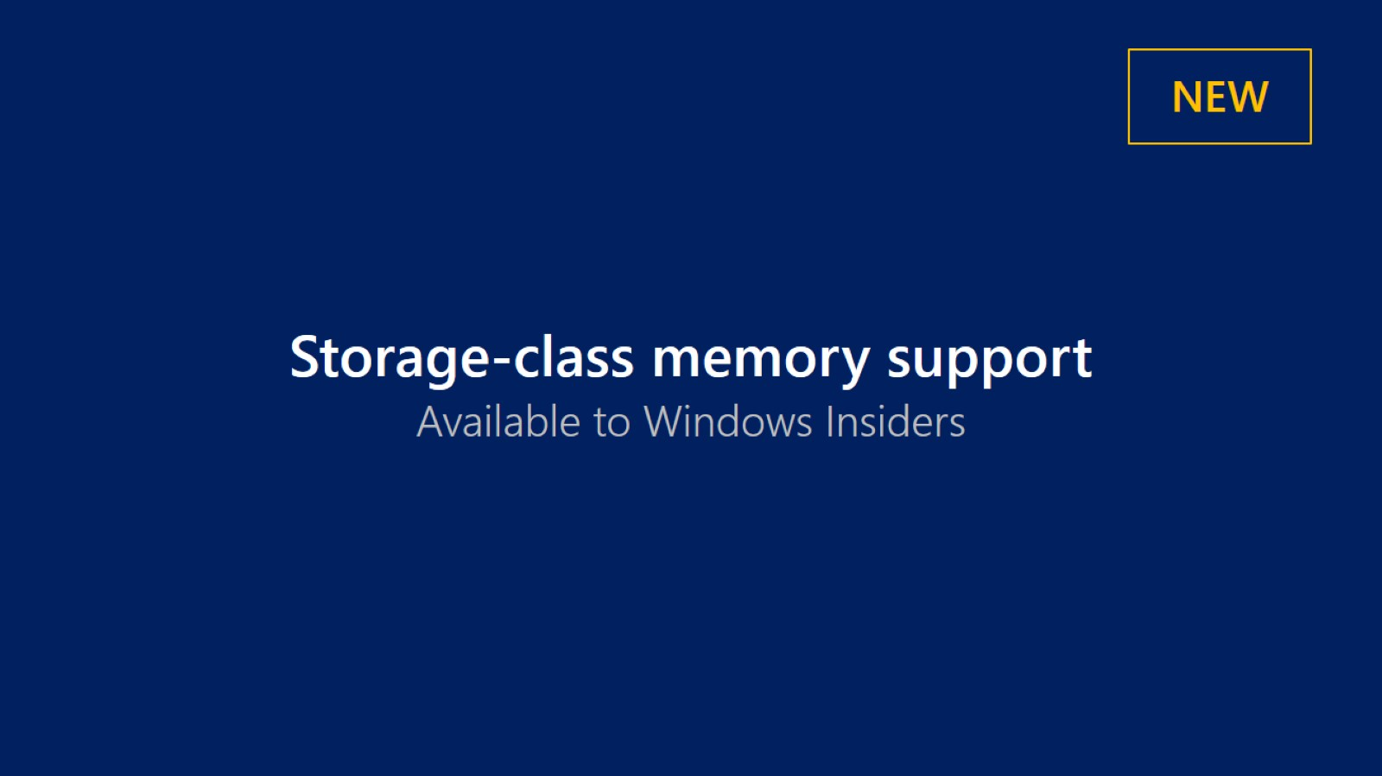

Slide 41
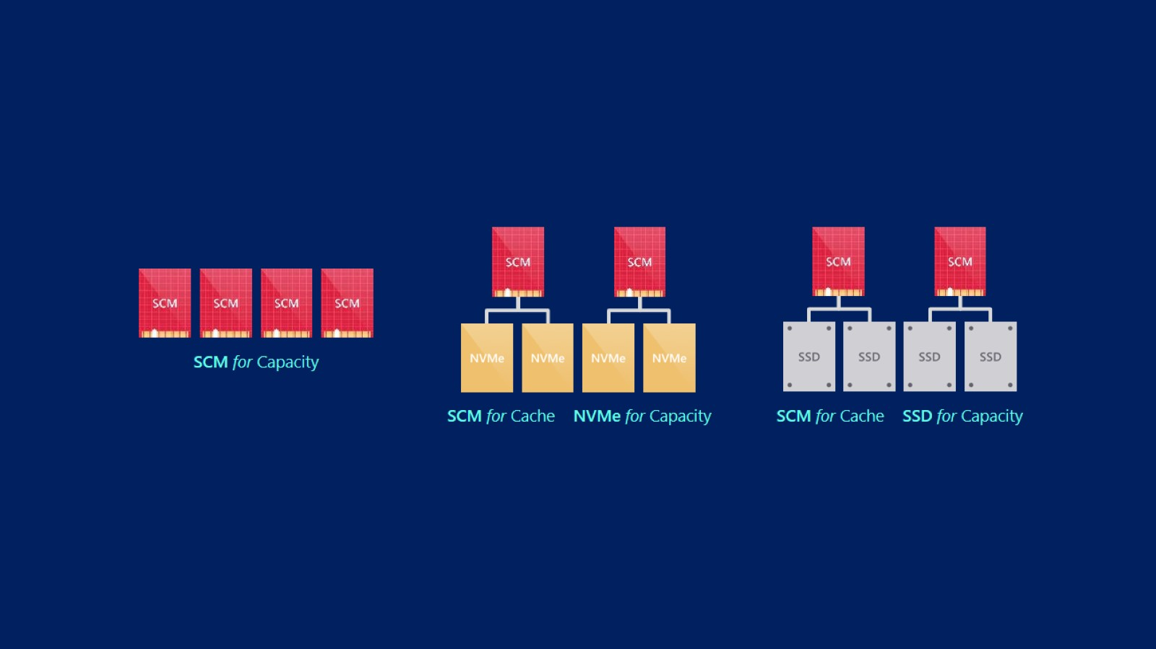

Slide 42
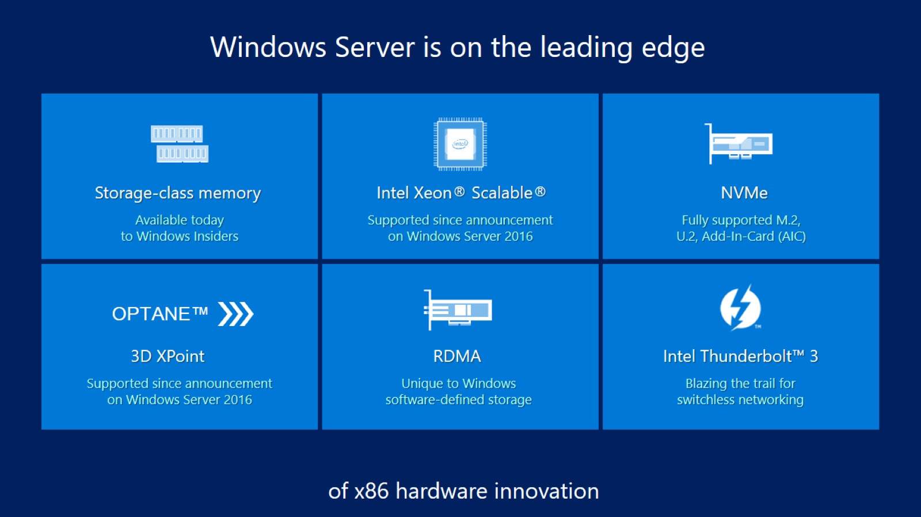

Slide 43
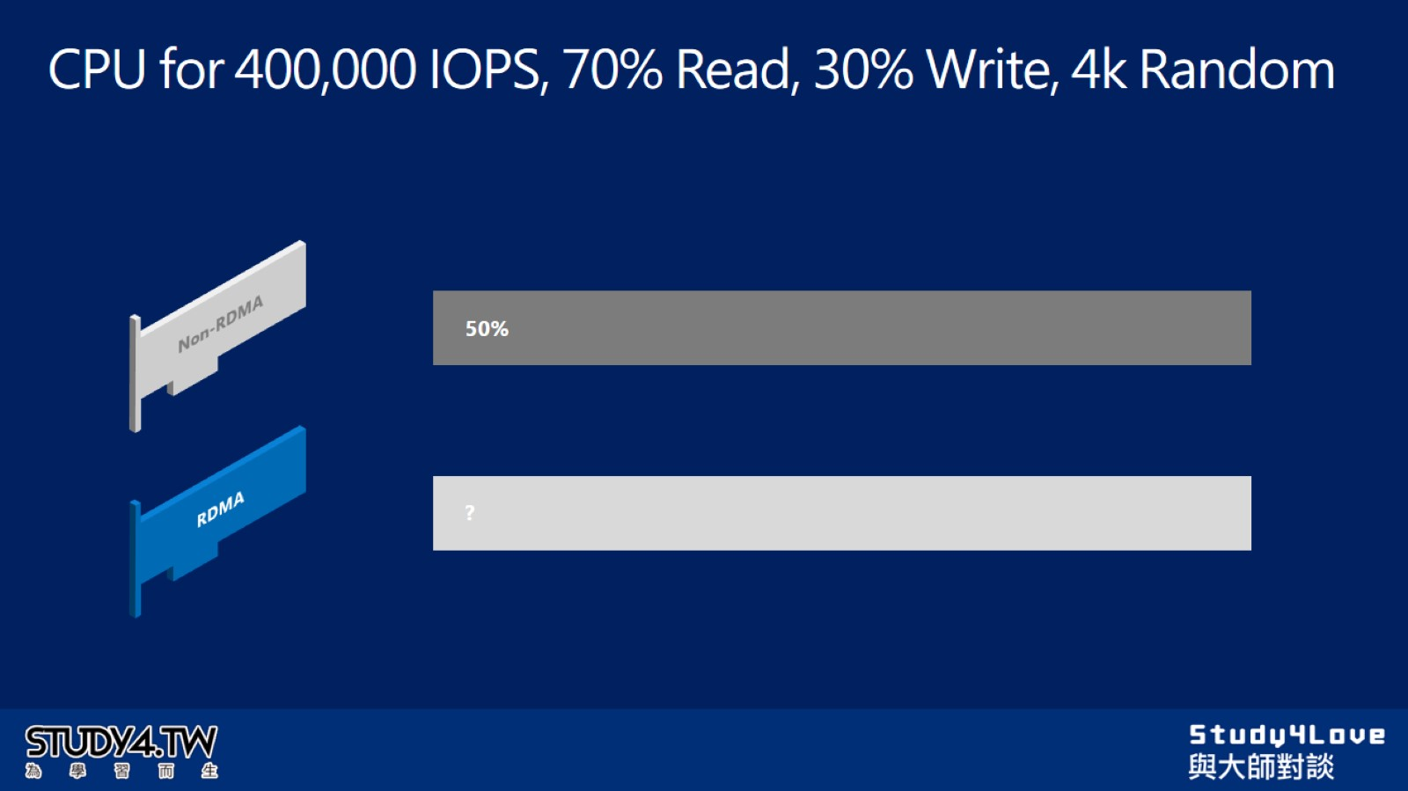
CPU for 400,000 IOPS, 70% Read, 30% Write, 4k Random

Slide 44
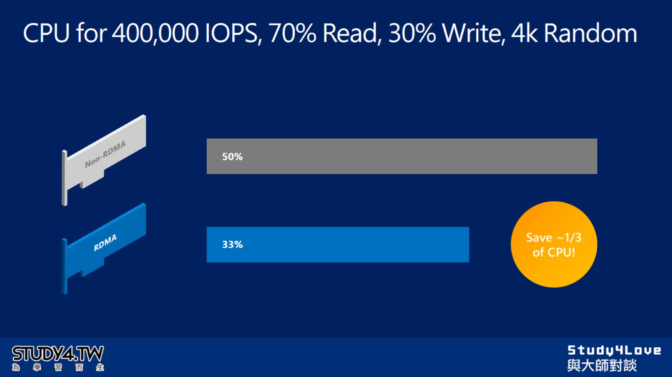
CPU for 400,000 IOPS, 70% Read, 30% Write, 4k Random

Slide 45
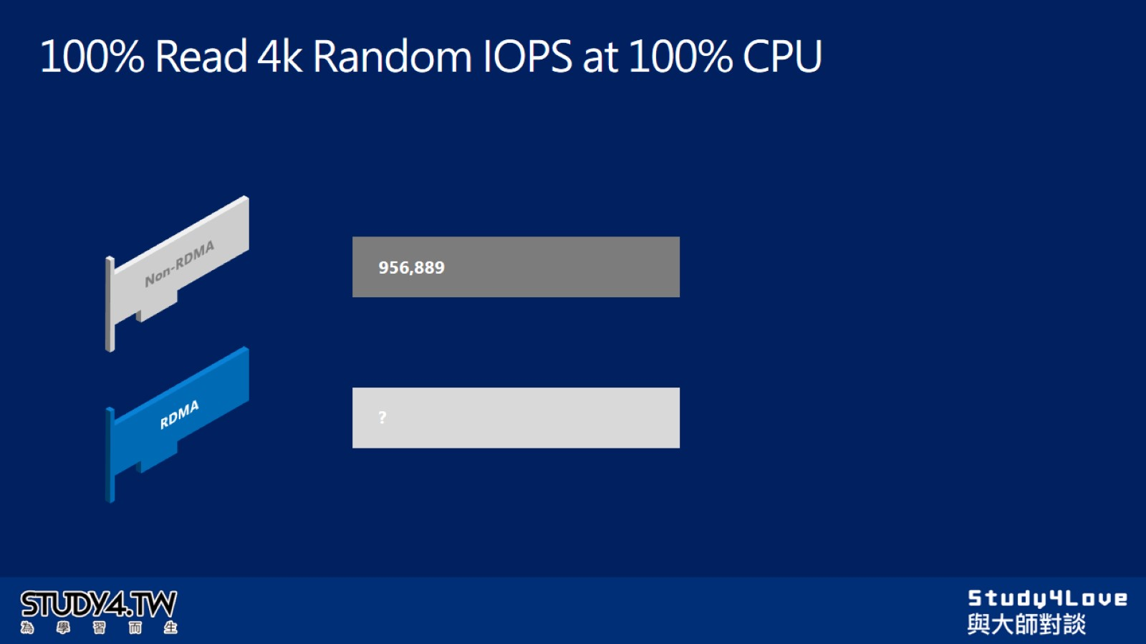
100% Read 4k Random IOPS at 100% CPU

Slide 46
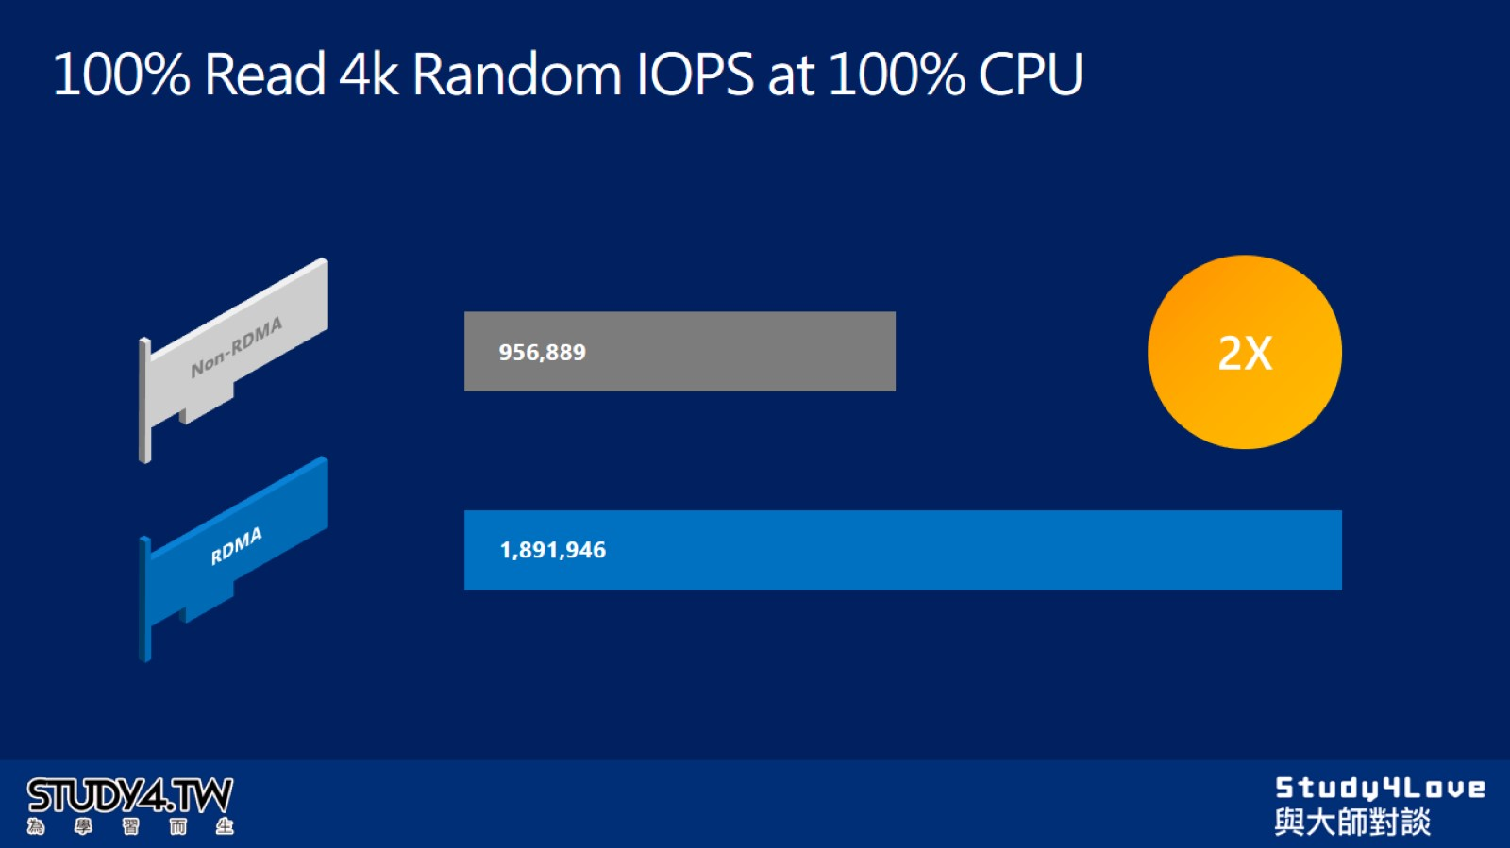
100% Read 4k Random IOPS at 100% CPU

Slide 47
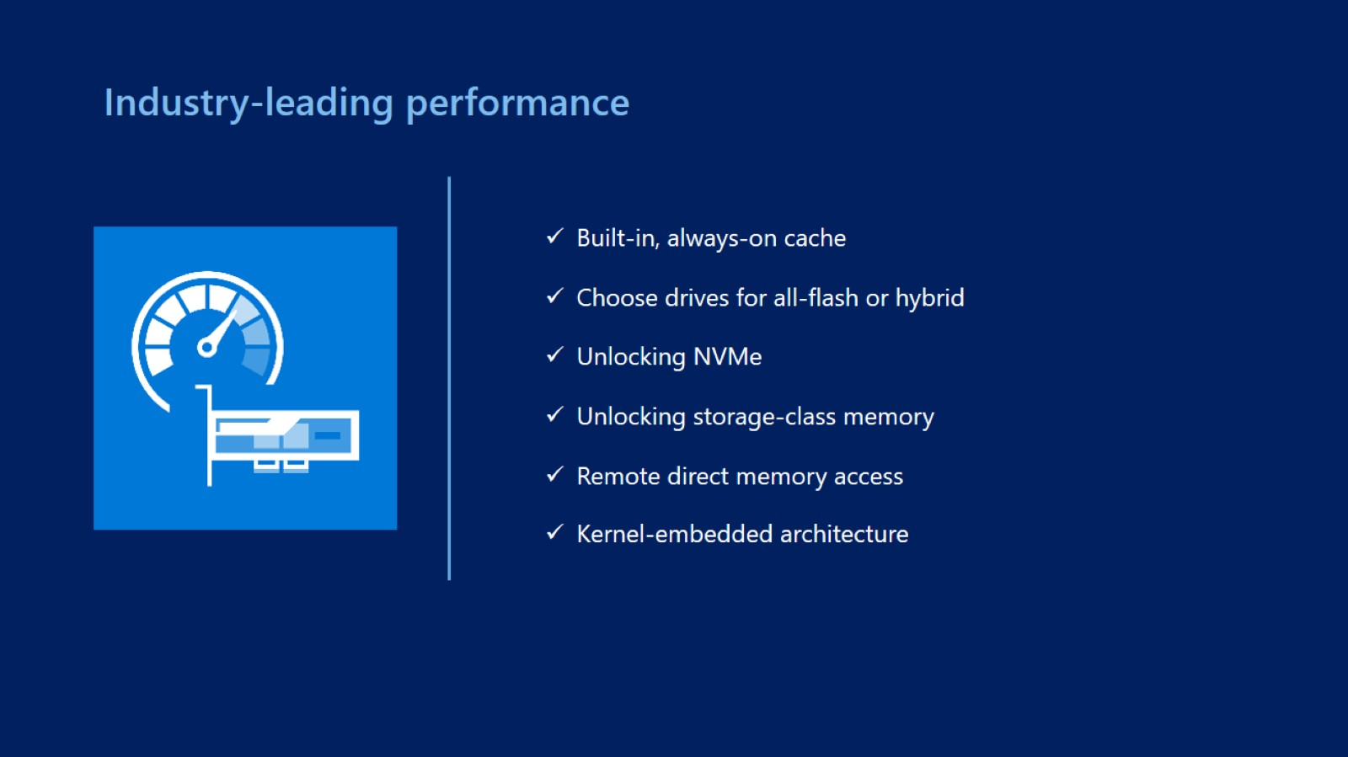

Slide 48
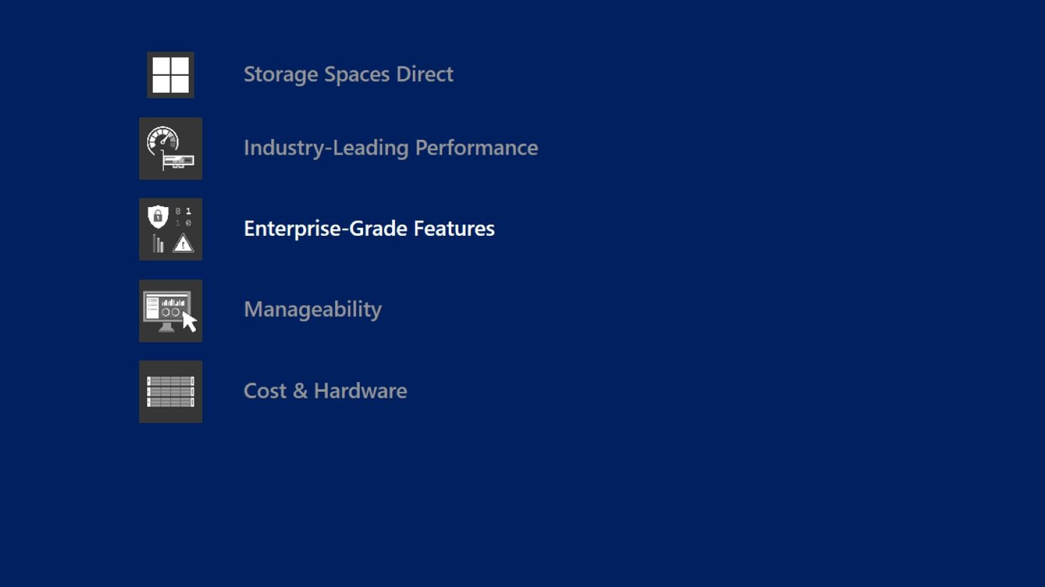

Slide 49
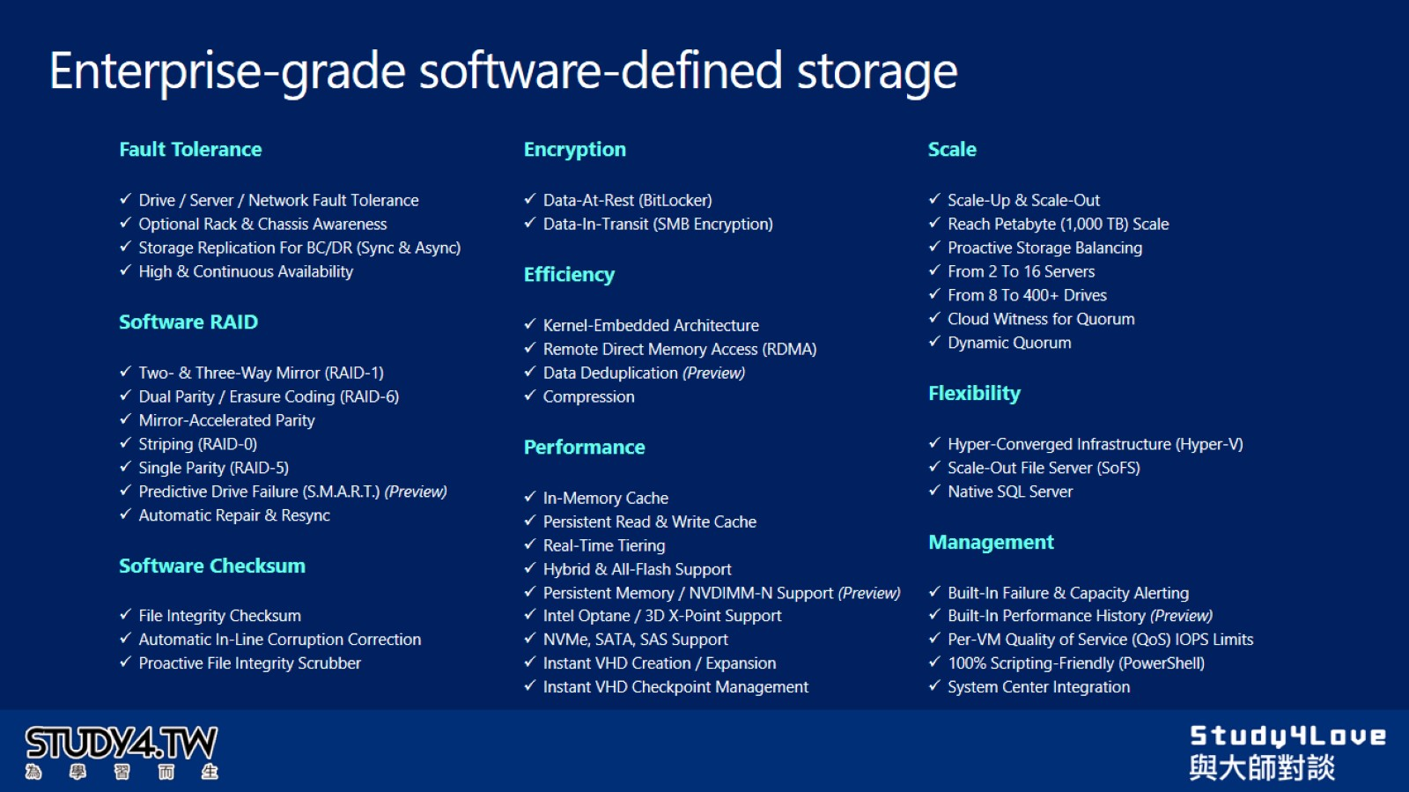
Enterprise-grade software-defined storage

Slide 50
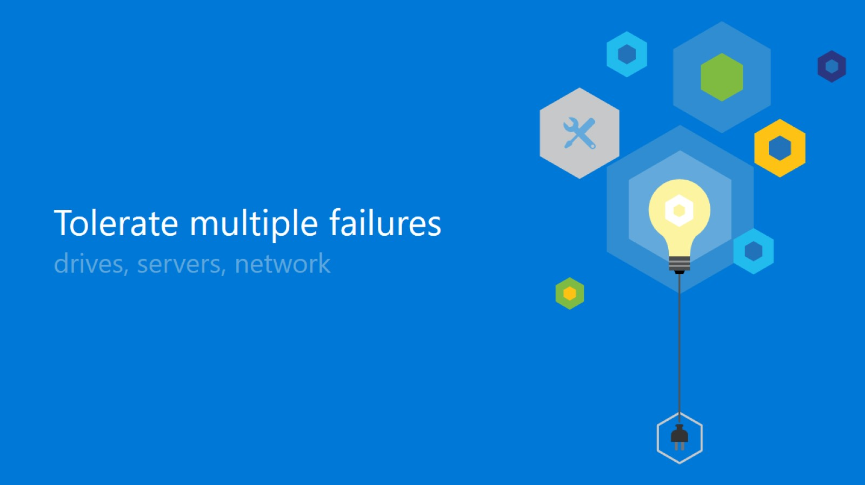

Slide 51
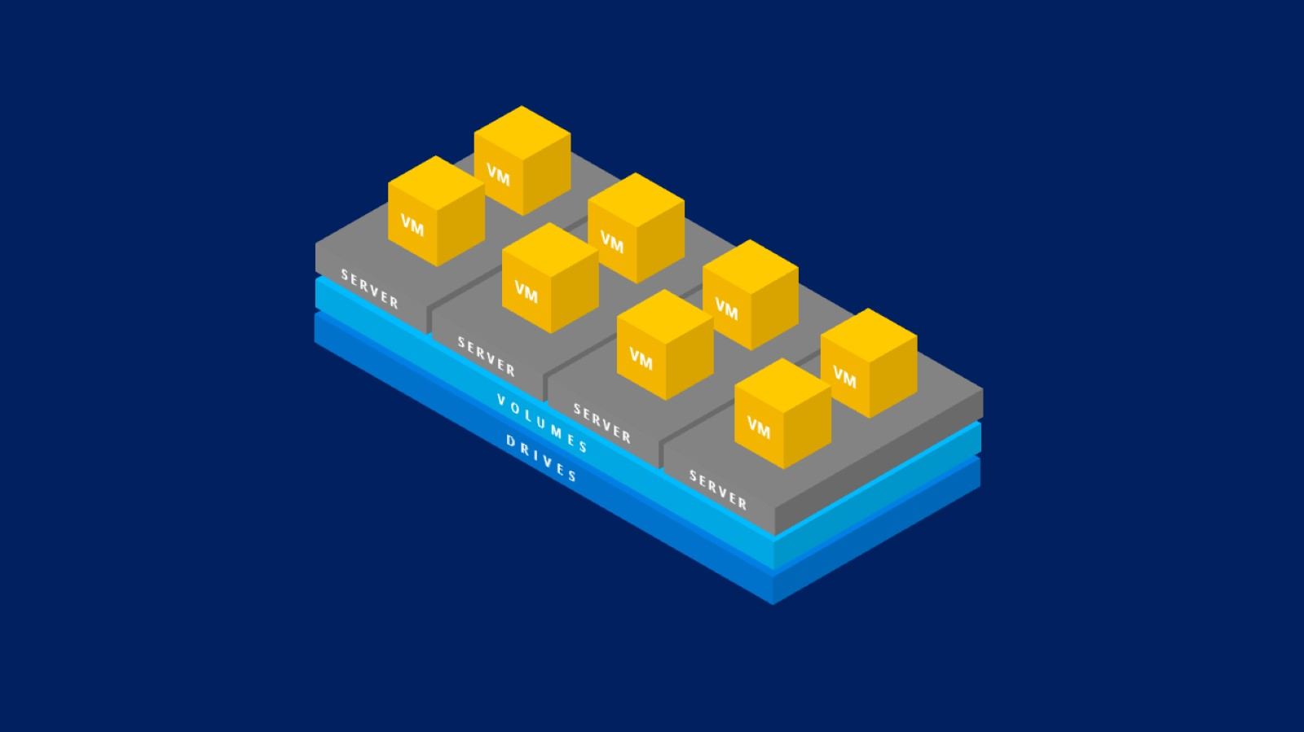

Slide 52
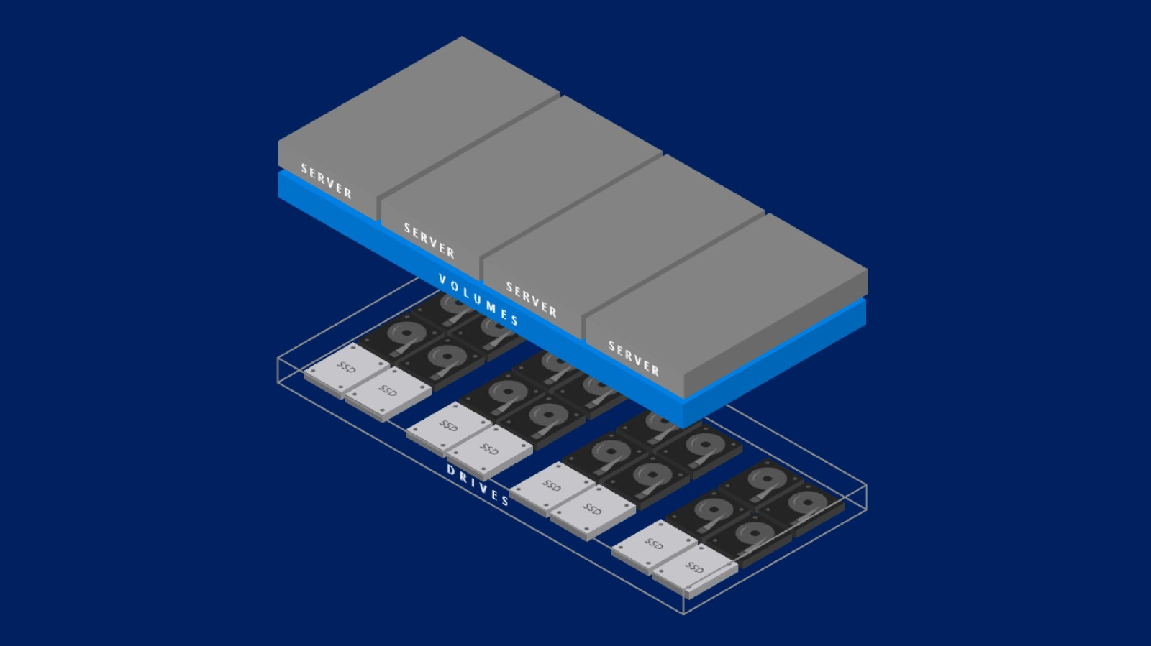

Slide 53


Slide 55


Slide 56


Slide 57


Slide 58


Slide 59


Slide 60


Slide 61


Slide 62


Slide 63


Slide 64


Slide 65


Slide 66


Slide 67


Slide 68


Slide 69


Slide 70

Mirroring is costly

Slide 71


Slide 72

Parity (“erasure coding”)

Slide 73


Slide 74


Slide 75

Scale

Slide 76


Slide 77

Deduplication and compression

Slide 78


Slide 79


Slide 80


Slide 81


Slide 82


Slide 83


Slide 84


Slide 85


Slide 86


Slide 87


Slide 88


Slide 89


Slide 90


Slide 91

Storage Replica Protection of key data and workloads

Slide 92


Slide 93

Storage Replica Synchronous and asynchronous modes

Slide 94

Recommendations for synchronous

Slide 95


Slide 96


Slide 97


Slide 98


Slide 99


Slide 100


Slide 101


Slide 102


Slide 103


Slide 104


Slide 105


Slide 106

Built-in performance history

Slide 107


Slide 108


Slide 109


Slide 110


Slide 111


Slide 112

Starwind Manager

Slide 113


Slide 114


Slide 115


Slide 116


Slide 117


Slide 118


Slide 119


Slide 120


Slide 121


Slide 122


Slide 123

Storage choice: Traditional SAN or Microsoft SDS

Slide 124

Storage Spaces Direct (S2D)

Slide 125

Storage Spaces Direct (S2D)

Slide 126

Reference

Slide 127


Slide 128

Thanks You

Slide 129


